Slide 1
Adult Peer Support Specialist Certification

Slide 2
Adult Peer Support Specialist
Welcome
The first to help you up are the ones who know how it feels to fall down.
What does a Peer Support do?
By sharing their own lived experiences and practical guidance, peer support specialists help people to develop their own goals, create strategies for empowerment, and take concrete steps toward building fulfilling, self-determined lives for themselves.
.

Slide 3
Since 2020, over 37 million Americans aged 12 or older have used illegal drugs within the last 30 days.
Addiction is defined as a chronic, relapsing disorder characterized by compulsive drug seeking and use, despite adverse consequences. People with addiction use substances or engage in behaviors to become compulsive.
It is treatable, and prevention efforts and treatment approaches for addiction are generally as successful as those for other chronic diseases.
In 2022, there were 2,135 overdose deaths in Kentucky.

Slide 4
Core Competencies and Objectives
Core Competency 1 – Problem Solving
Participants will understand PICBA process as a method of problem solving.
Participants will look at several areas of conflict between peers and learn different methods of de-escalation and conflict management.
Participants will understand the APSS Code of Ethics and professional boundaries.
Participants will be able to identify suicidal behaviors and learn tools to assist in the prevention,
Participants will understand the 908 KAR 2:220 and the definition and guidance it provides as to who and what APSS are, and what they do.
“Knowing is not enough; we must apply.”
- Johann Wolfgang van Goethe

Slide 5
P
Problem
I
Impact
C
Cost and/or Benefits
Brainstorm
B
Actions
A

Slide 6
PICBA
First step is to identify and define the problem.
This involves understanding what the issue is and why it's a problem. the problem they identify might not always be the actual problem that exists. When identifying the problem, they must look deeper than just the surface.​
​
You will assist them in conducting a “root-cause analysis” to determine the issue. To get to the root of the problem, you can use the “5 Whys Method”. The “5 Whys Method” was originally developed by Sakichi Toyoda. Toyoda found that “by repeating “why” five times, the nature of the problems and its solution becomes clear.” ​
For example: ​
​
Julie says that her anxiety has been worse than ever, and she has had several panic attacks recently. Julie identifies her problem as panic attacks. But when you dig deeper and ask Julie why she is having panic attacks, Julie says that she has been under much stress lately. Asking why again reveals that Julie has been under pressure because she has a disconnect notice on her electricity. Why does Julie have a disconnect notice on her electricity? Because she is having financial problems. Why is Julie having financial problems? Because she is only getting part-time hours at work. Why? At the time, I only needed part-time hours and didn’t apply for a full-time position.​
​
So, after looking at the issue using this approach, is Julie’s problem her panic attacks, or are her panic attacks the result of an underlying problem?​
​
Once you have helped identify the problem, framing it clearly and concisely is crucial. Using this example, Julie’s “problem” could be identified clearly and concisely by stating, “Julie is not earning enough money at her job to pay all of her bills each month because she is only working part-time hours at work.”,​

Slide 7
PICBA
The second step is identifying the impact.
In this step, ask the individual how they are impacting the problem. In the previous example, Julie identified her problem as not making enough money to pay her monthly bills, because of her part-time employment. ​
​
ASK: What are some potential ways in which Julie is impacting this problem.? (Acknowledge answers)​
​
Potential answers:​
​

Slide 8
PICBA
The third step is to assist them with weighing the costs and benefits of solving the problem.
What are the costs of Julie NOT working towards solving the problem?
​
Potential Answers:​
​
What are the benefits of Julie working towards solving the problem?
Potential Answers:​

Slide 9
PICBA
The fourth step is to brainstorm potential ways to address the problem. The person should identify 3-5 potential ways they would work towards a solution to their problem.
What are 3-5 ways that Julie can address her problem
​
Potential Answers:​

Slide 10
PICBA
The final step is to consider all the previous steps you have worked through, and based on that information (cost/benefits, brainstorming, solutions), you will help Julie decide on 1-2 actions to take to solve her problem. After producing 1-2 solutions, assist Julie in creating an action plan to use as a tool to solve her problem effectively.
What are some actions that Julie could take now to solve her problem?​
Potential Answers
​
Once Julie has identified some action that she can take to solve her problem, work with her to create an Action Plan. This plan should outline the steps required to implement the solution, identify responsibilities, set deadlines, and identify resources.​
​
ASK: What may Julie’s Action Plan consist of? ​
Potential Answers​
​
​

Slide 11
PICBA – Problem Solving Worksheet
PROBLEM
What is the current situation, and what is the current situation keeping me from doing what I would like to do?
IMPACT
How am I negatively impacting the situation or helping to create the problem?
COST/BENEFITS
If the problem is not resolved, what is the cost in the short term? What’s going to happen in the long term? If the problem is resolved, what are the short-term benefits? What would be some of the long-term benefits?

Slide 12
PICBA – Problem Solving Worksheet
PROBLEM
What is the current situation, and what is the current situation keeping me from doing what I would like to do?
IMPACT
How am I negatively impacting the situation or helping to create the problem?
COST/BENEFITS
If the problem is not resolved, what is the cost in the short term? What’s going to happen in the long term? If the problem is resolved, what are the short-term benefits? What would be some of the long-term benefits?

Slide 13
Insert 2-page Code of Ethics for APSS

Slide 14
Protocol for Working With Someone Who Is Possibly Having Suicidal Thoughts or Actions
Ask
• How?
o Asking the question “Are you thinking about suicide?” communicates that you are open to having an open discussion about suicide in a non-judgmental and supportive way. Asking in this direct, unbiased manner can open the door for effective dialogue about their emotional pain and can allow everyone involved to see what next steps need to be taken. It shows that you value them as a person, and that you are there for them.
Keep Them Safe
• How?
O First off, it is good for everyone to be on the same page. After the “Ask” step, and you have determined that suicide is indeed being considered or talked about, it is important to find out a few things to establish immediate safety.
o Have they already done anything to try and kill themselves before talking with you?
o Does the person experiencing thoughts of suicide know how they would kill themselves?
O Do they have a specific detailed plan?
o What is the timing of their plan?
Be There
• How?
o This could mean being physically present for them, speaking with them on the phones when you can, or any other way that shows support for the person at risk.
o An important aspect of this step is to make sure you follow through with the ways in which you will be able to support the person.
o Do not commit to anything that you are not willing or able to accomplish.

Slide 15
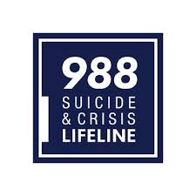
Protocol for Working With Someone Who Is Possibly Having Suicidal Thoughts or Actions
Help Them Connect
• How?
O Helping someone with thoughts of suicide connect with ongoing support (like The Lifeline, which can be found by dialing 988 on any phone) can help them establish a safety net for those moments they find themselves in a crisis.
O Additional components of a safety net might be connecting them with support and resources in their local communities, such as counselors. As peer support, connect them with a clinician, or as them if would like to be connected with a clinician. Inquire if they would like you to be present with them when they speak to the clinician.
Follow Up
• How?
O After your initial contact with a person experiencing thought of suicide, and after you have connected them with the immediate support systems they need, make sure to follow up with them to see how they are doing. Send a text, call, or visit them. As peer support, you have a unique ability to follow a client when they have been admitted and continued providing peer support services. This consistency is one of the biggest components for a peer support, and for a client.

Slide 16
Core Competencies and Objectives
Core Competency 2 – Wellness Recovery Action Plan (WRAP)
Participants will understand the components of WRAP. They will develop a maintenance plan and crisis plan for when things are breaking down.
Participants will be able to identify triggers and early warning signs.
Participants will understand the components of an Advance Directive for Mental Health Treatment (ADMHT) and will participate in the creation of one.
Participants will understand the importance of behavioral self care and self wellness.
“Knowing is not enough; we must apply.”
- Johann Wolfgang van Goethe

Slide 17
Insert 4-page KY Advanced Directive for Mental Health
Insert 63-page Morbidity and Mortality In People with Serious Mental Illness report

Slide 18
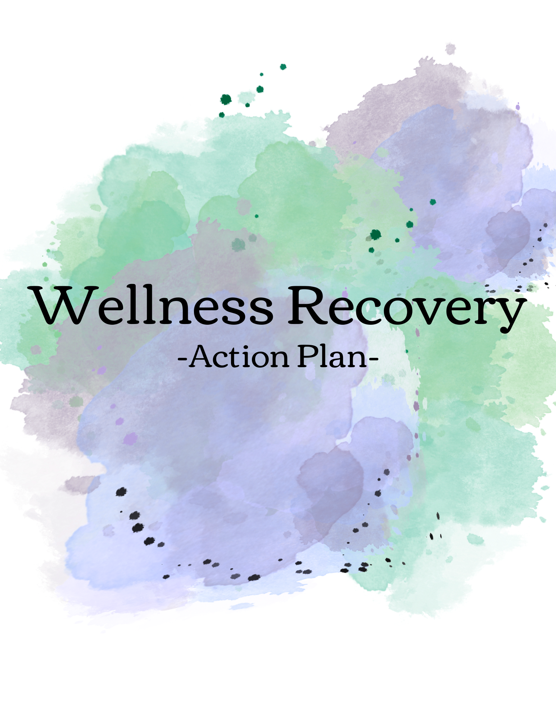

Slide 20
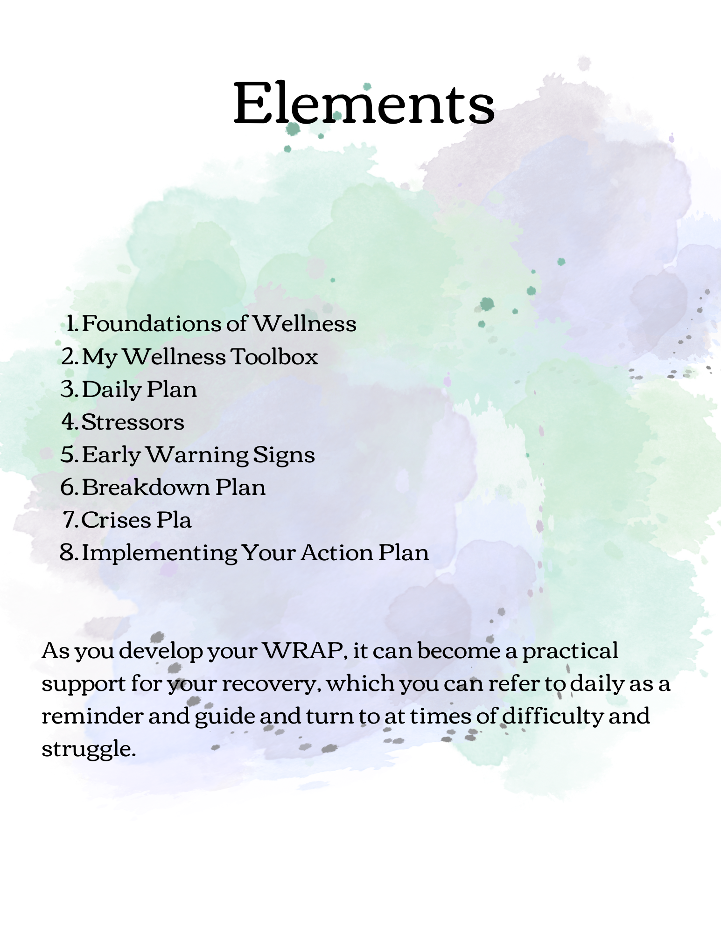

Slide 21
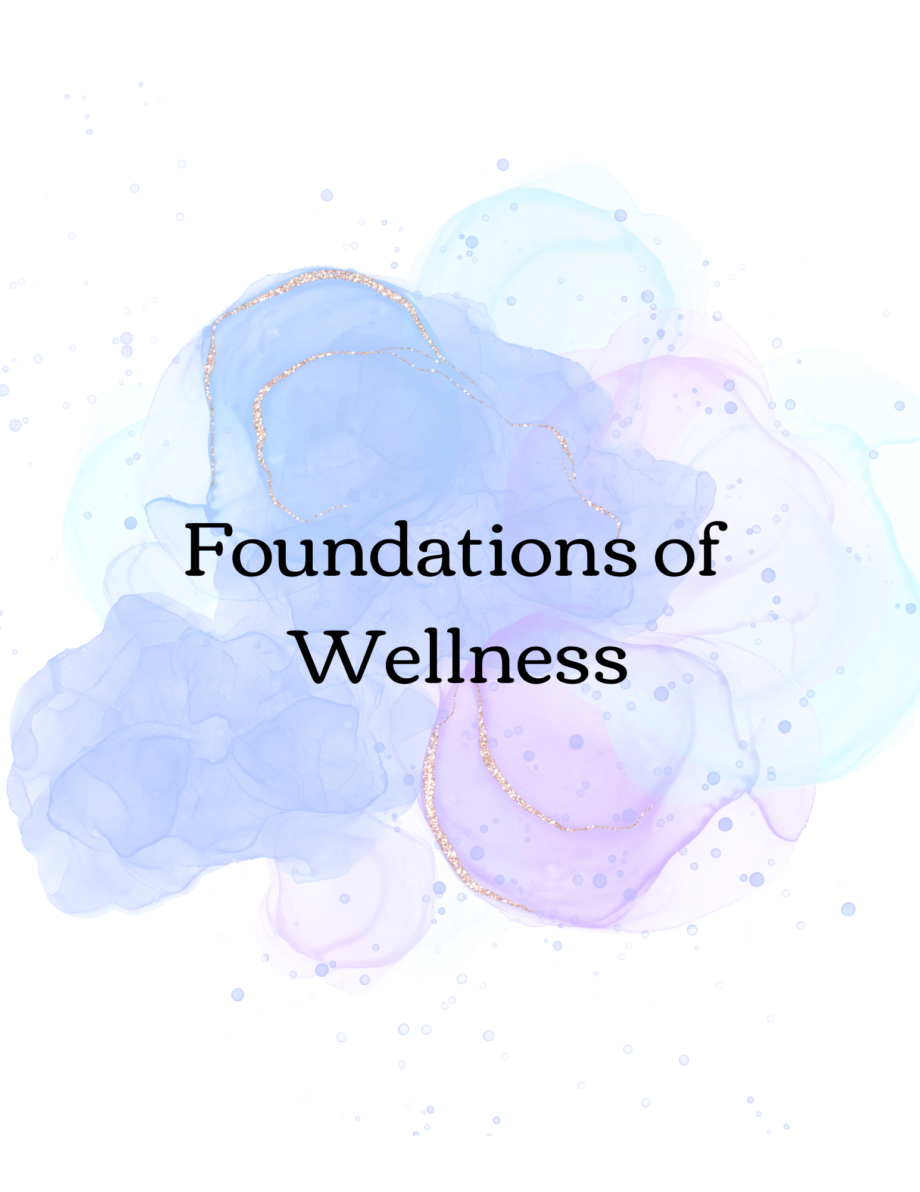

Slide 23
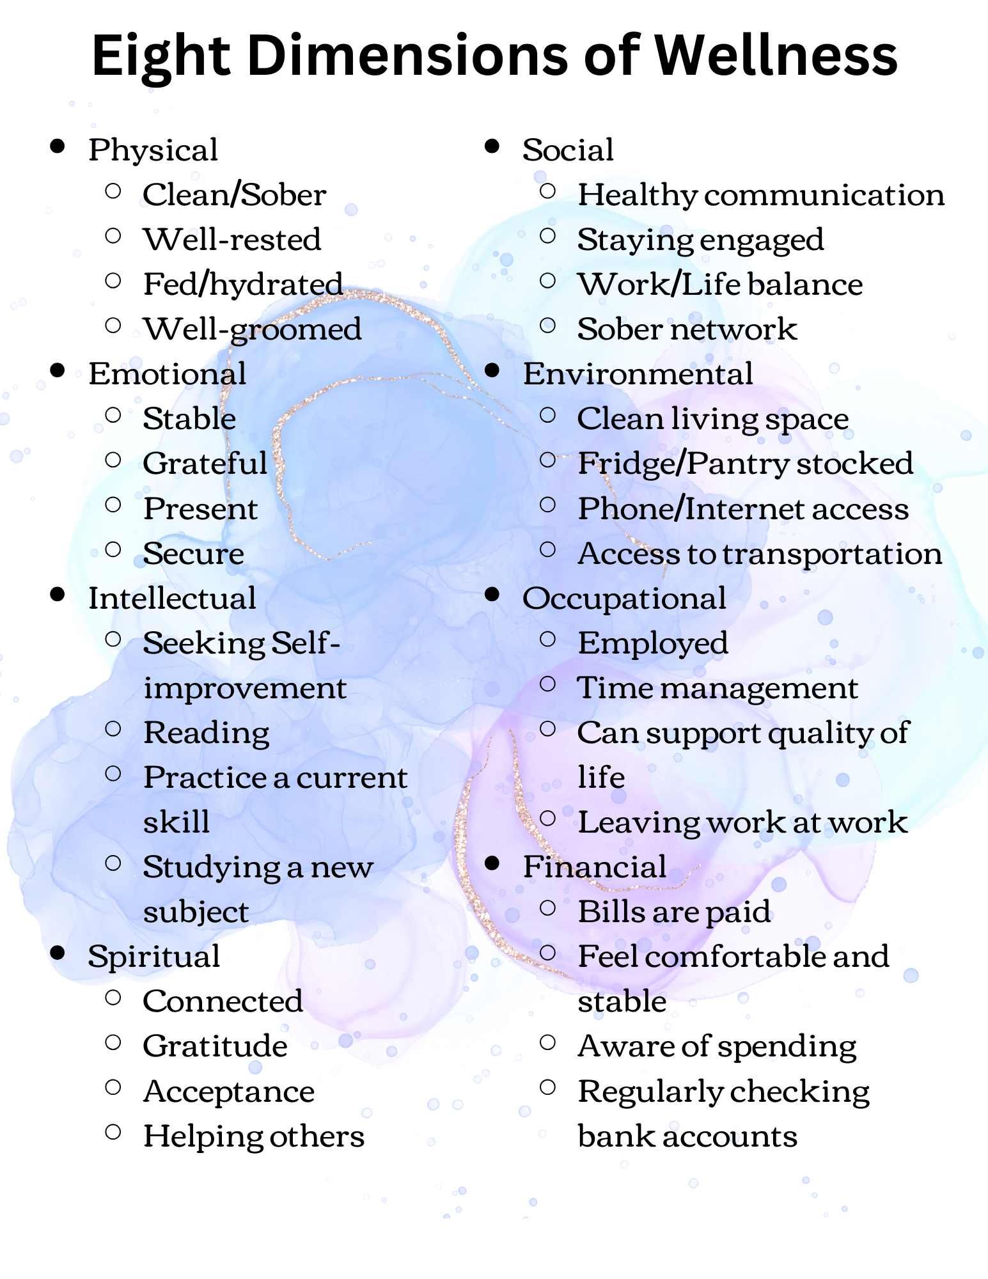

Slide 25
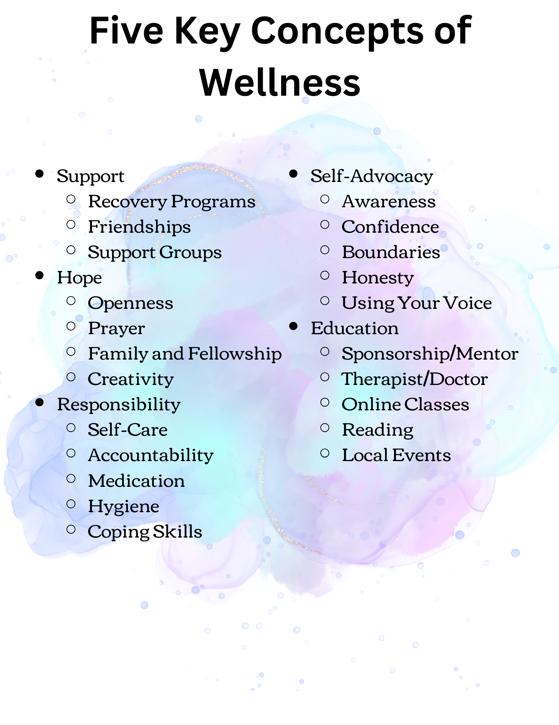

Slide 26
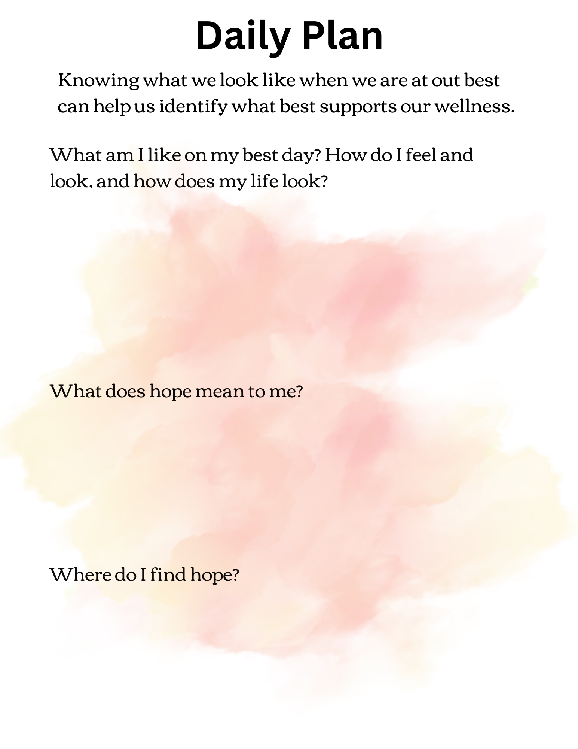

Slide 27
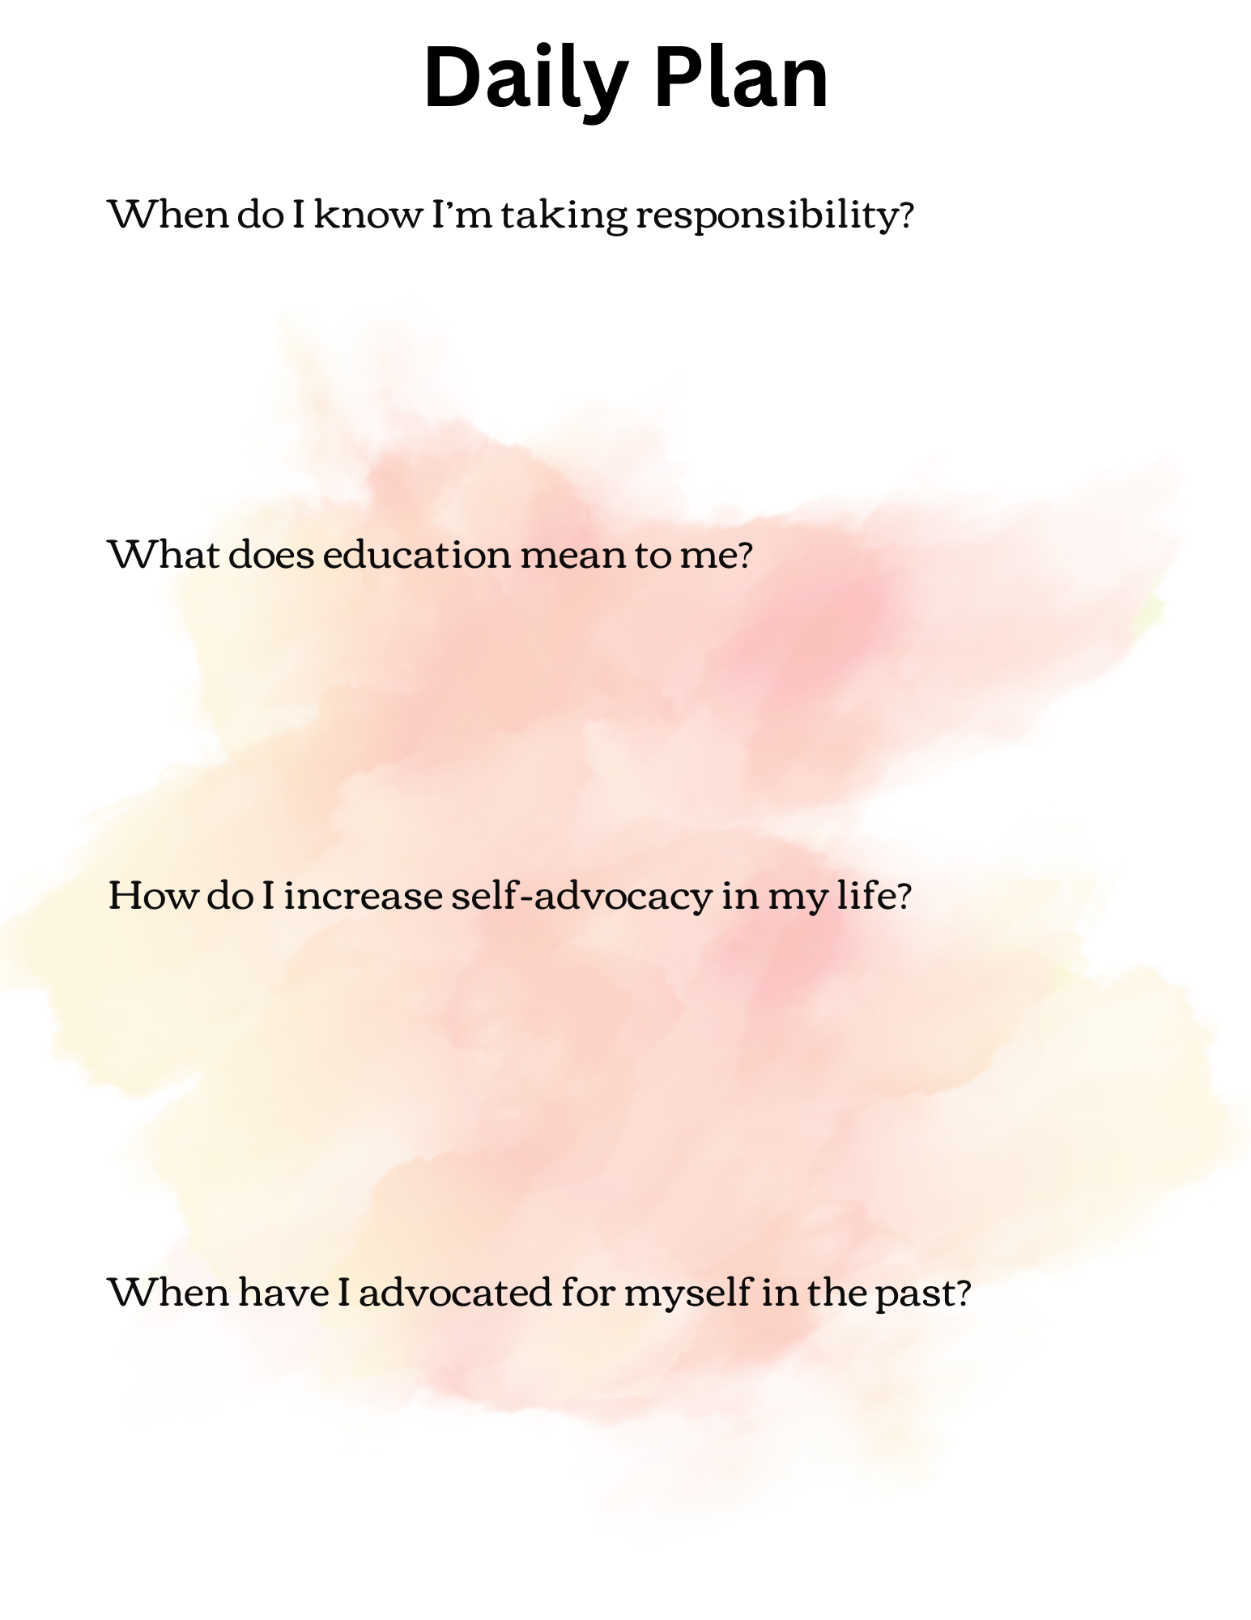

Slide 28
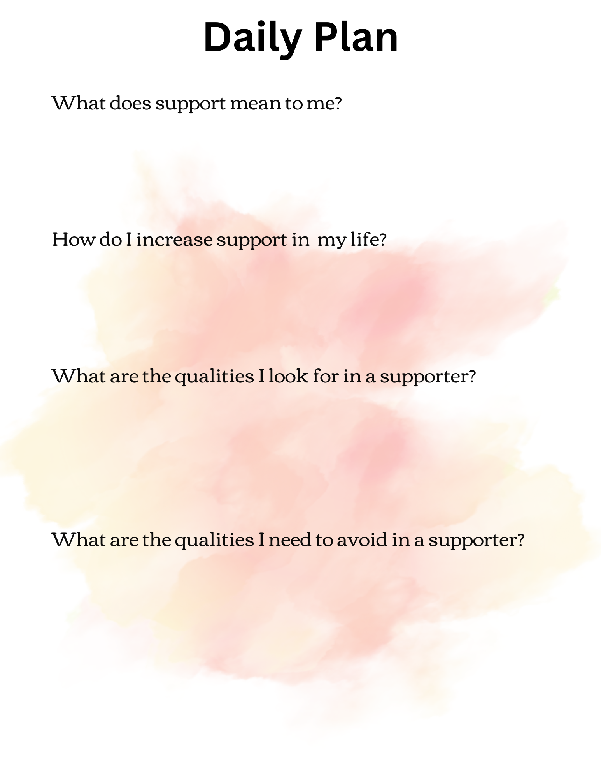

Slide 29
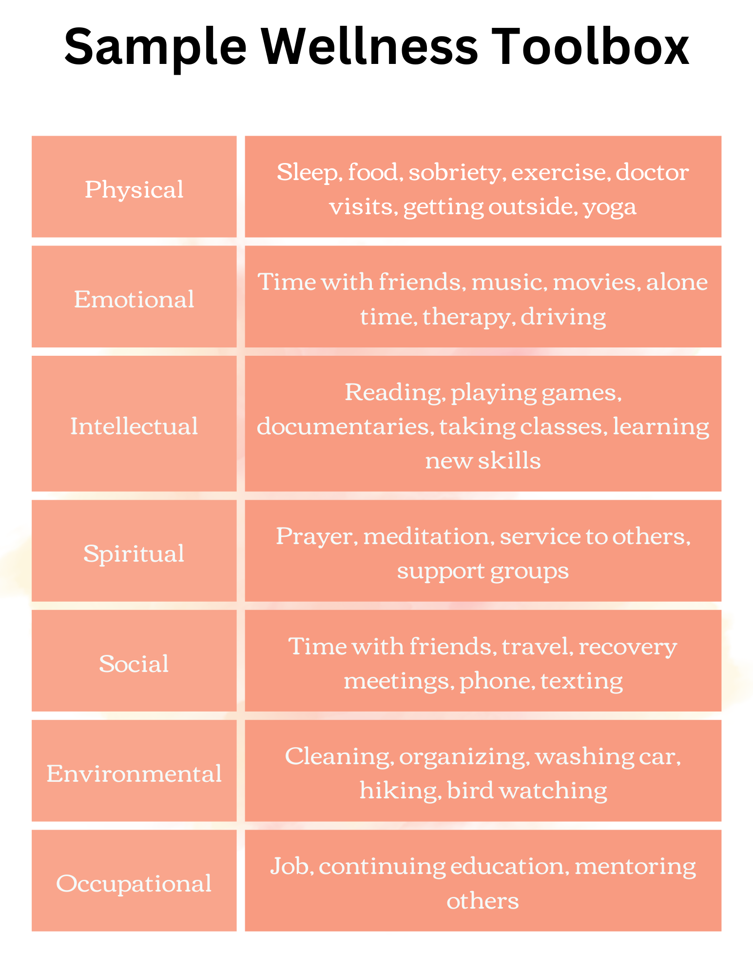

Slide 30
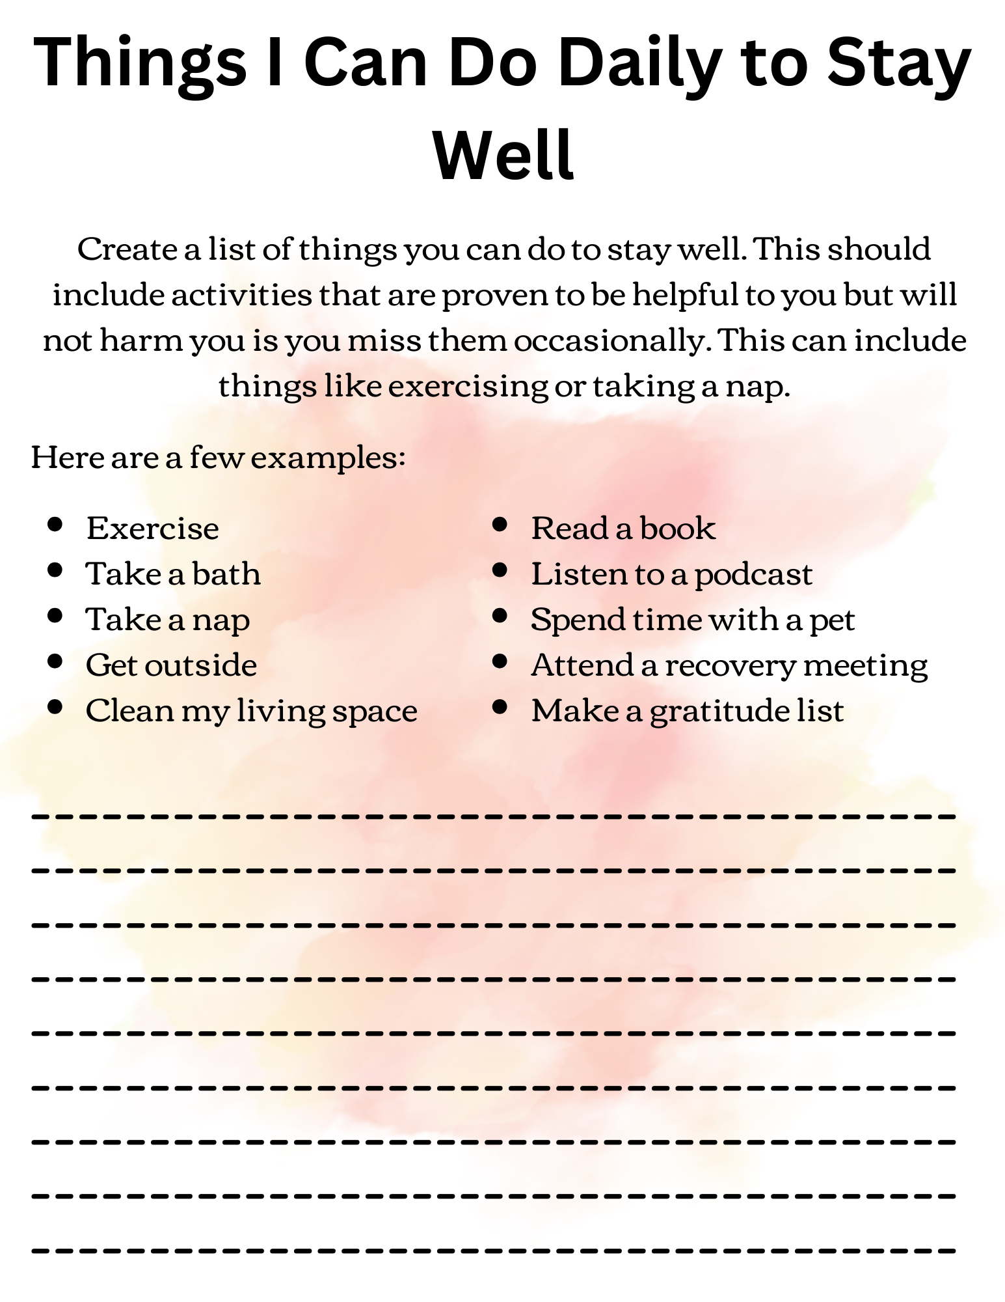

Slide 31
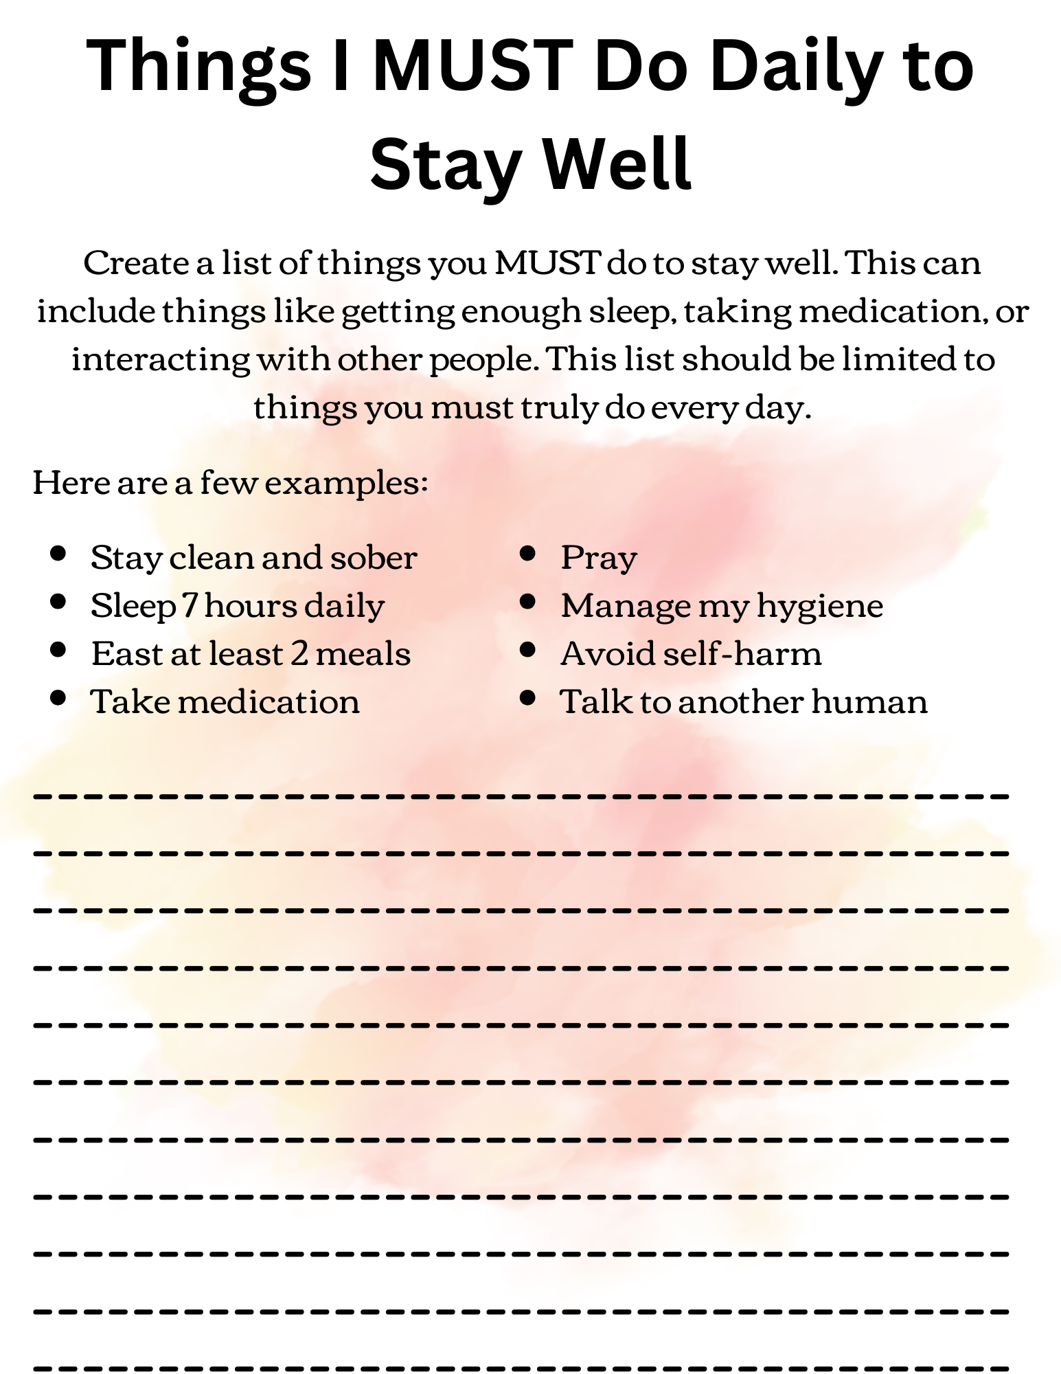

Slide 32
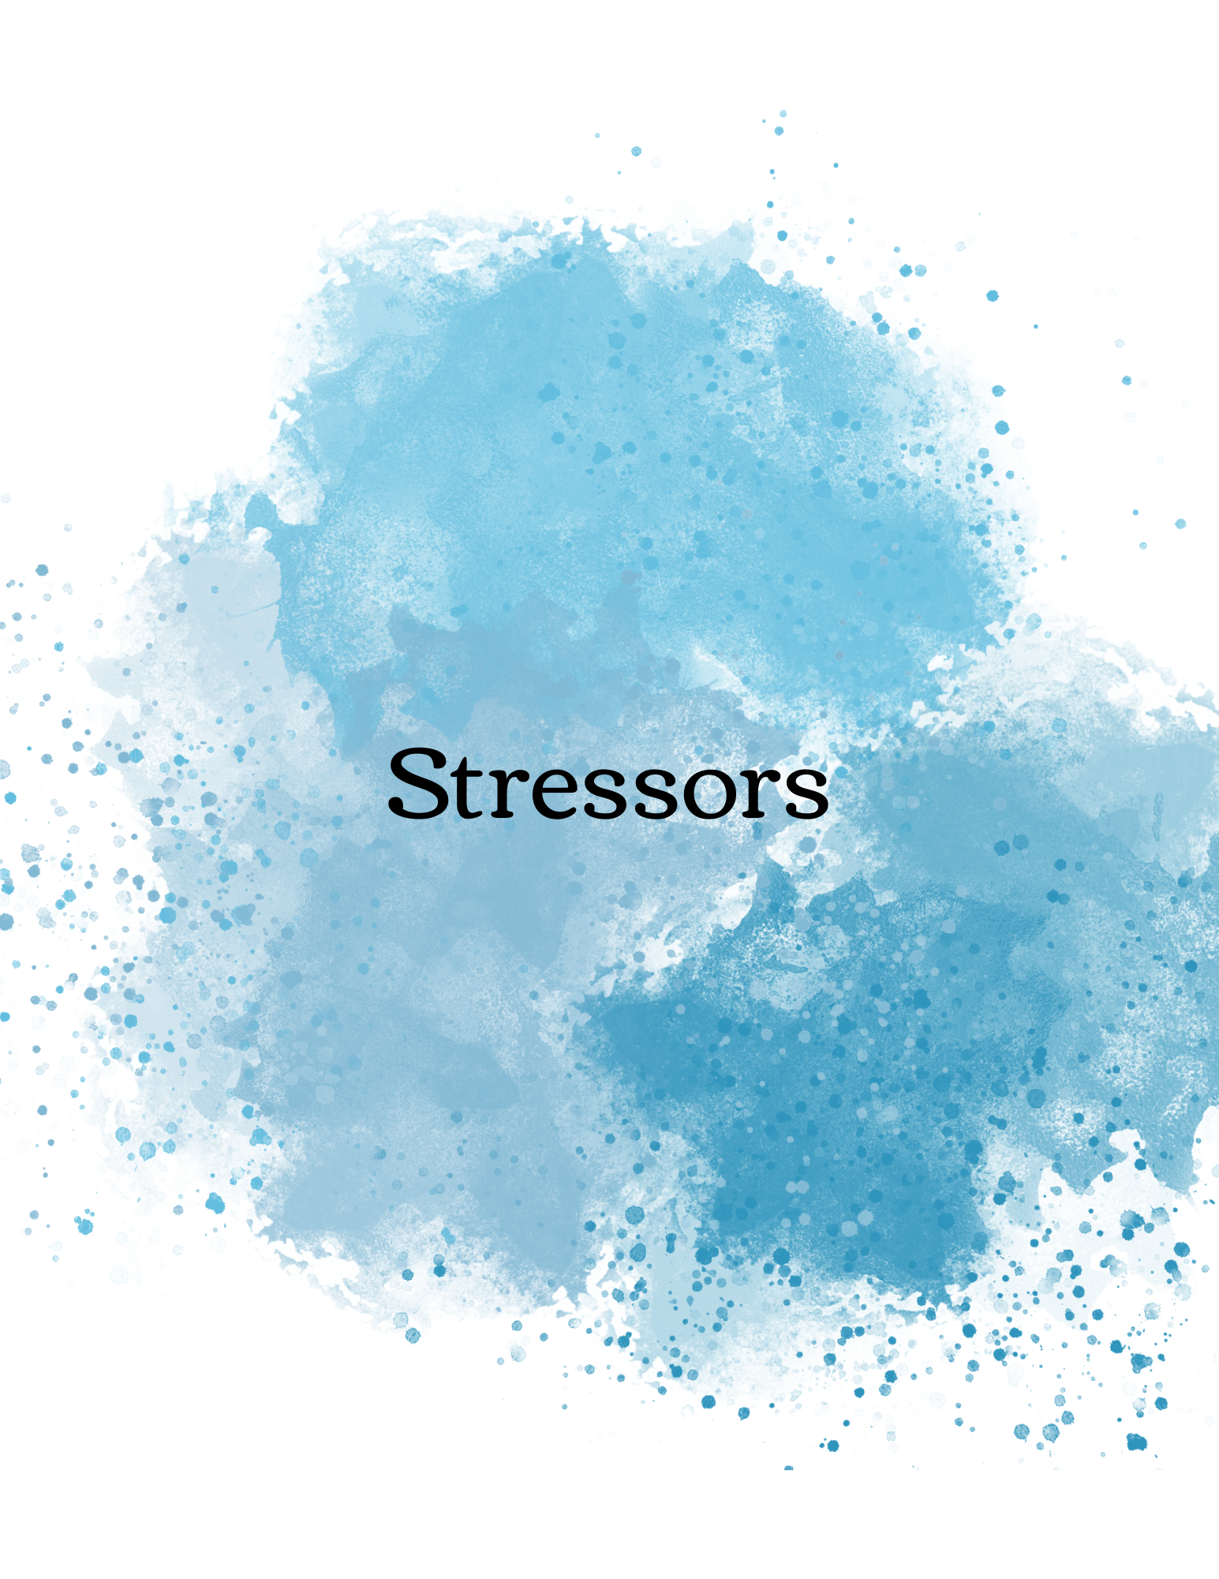

Slide 33
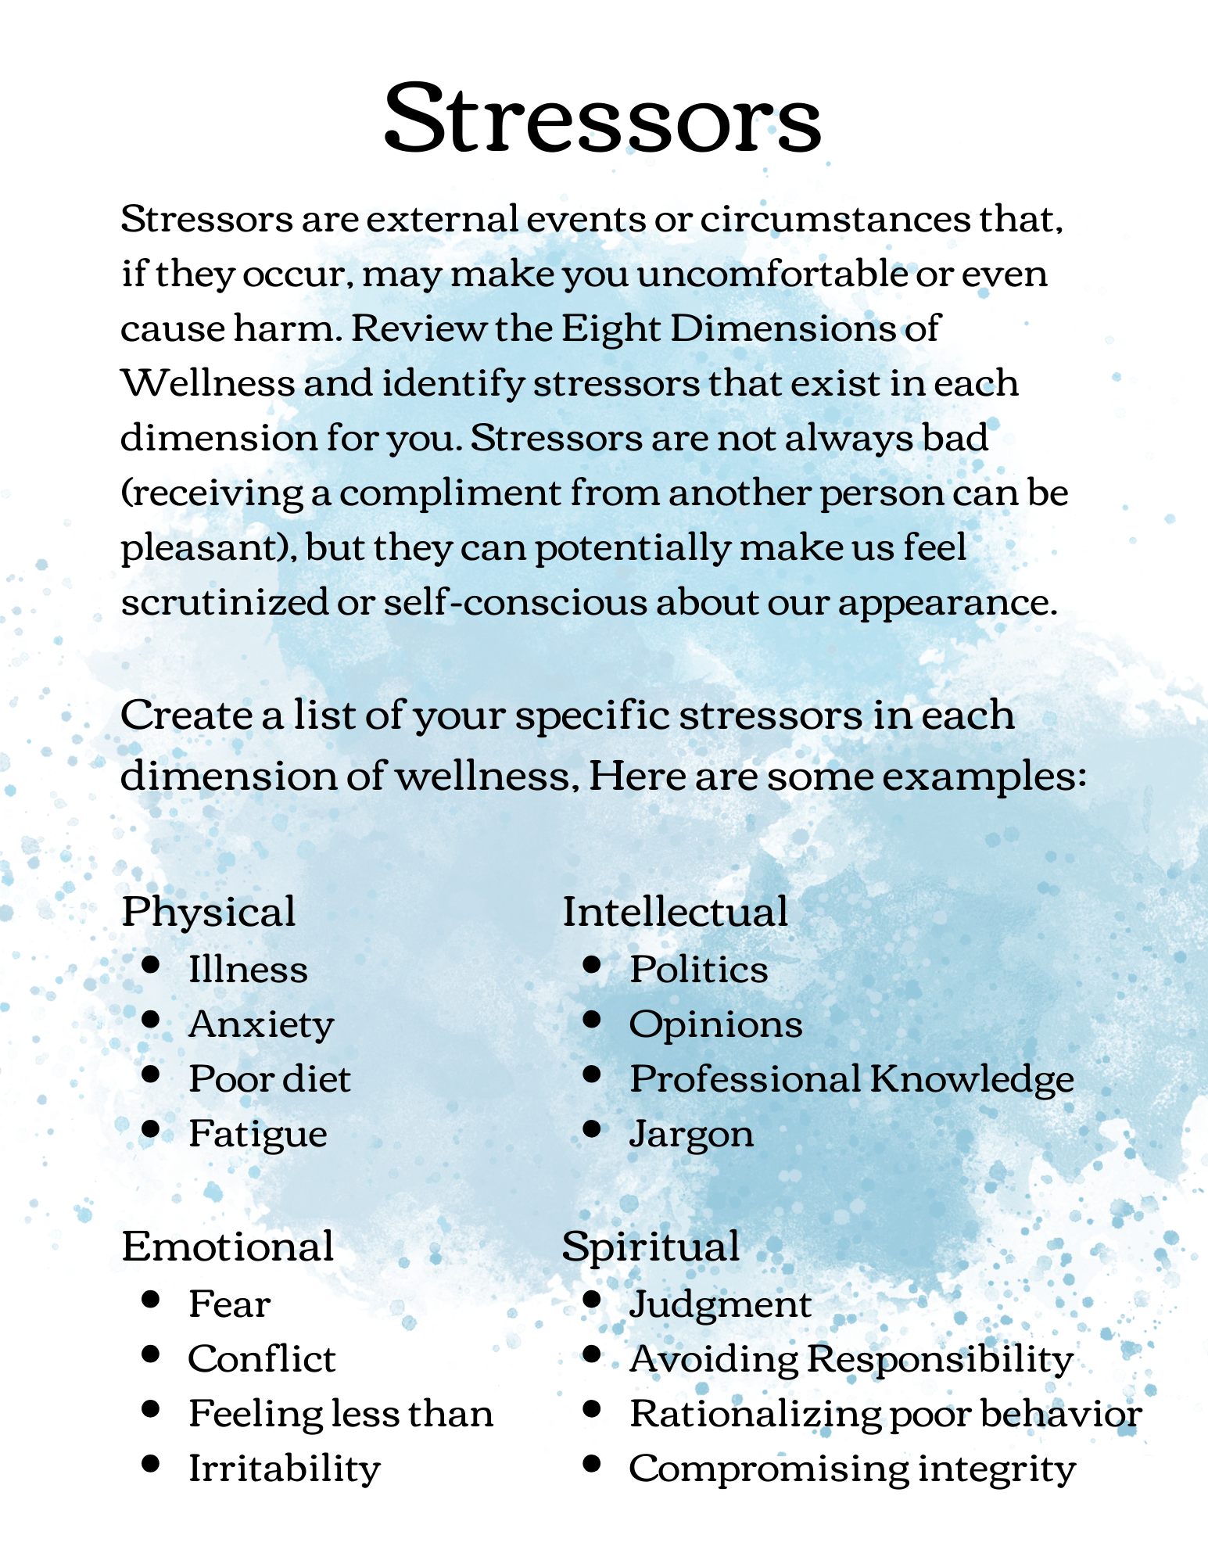

Slide 34
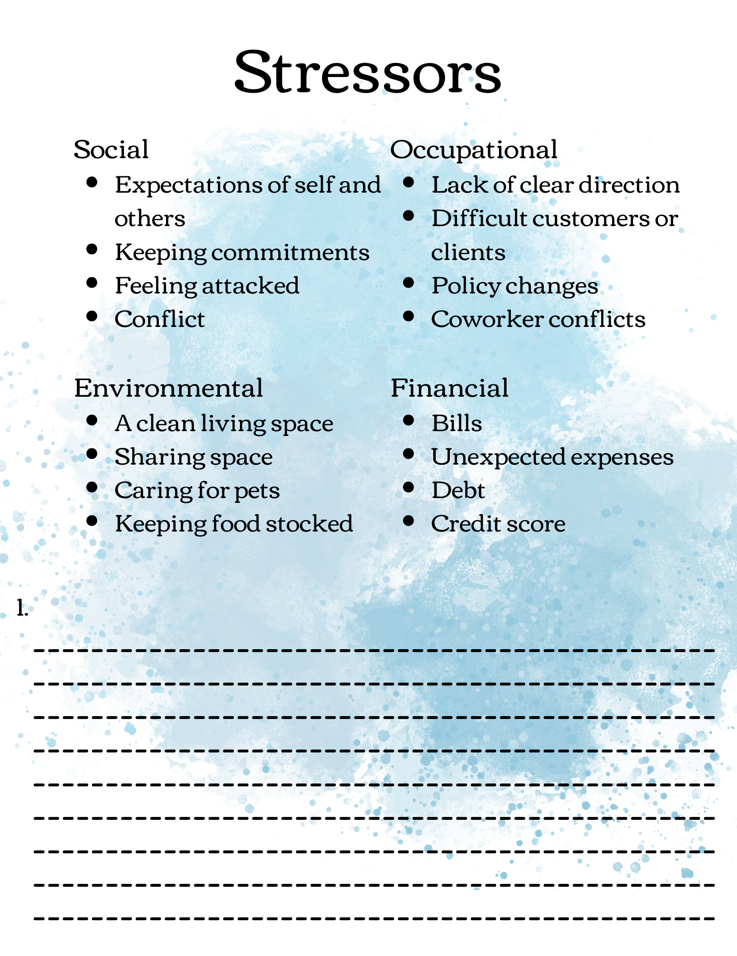

Slide 36
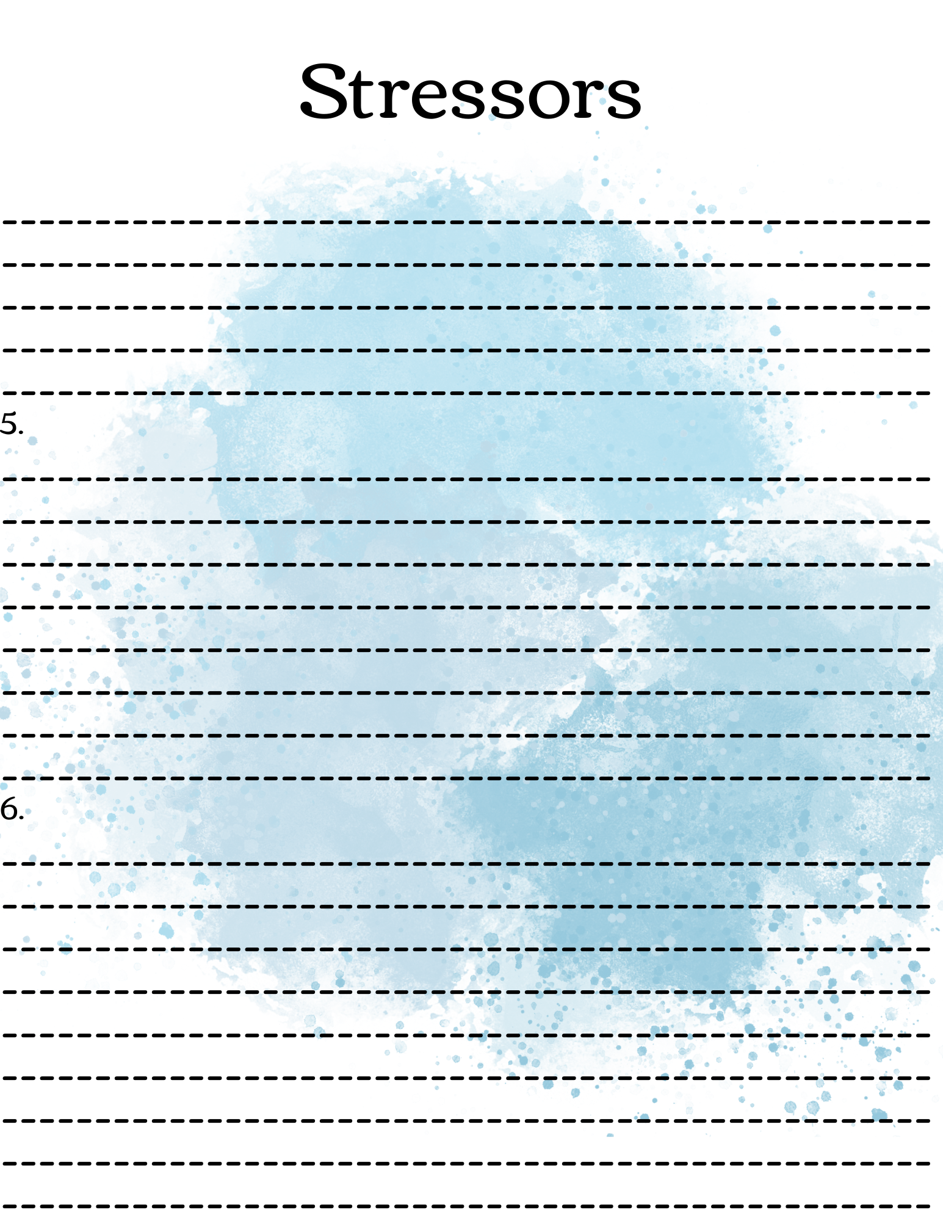

Slide 38
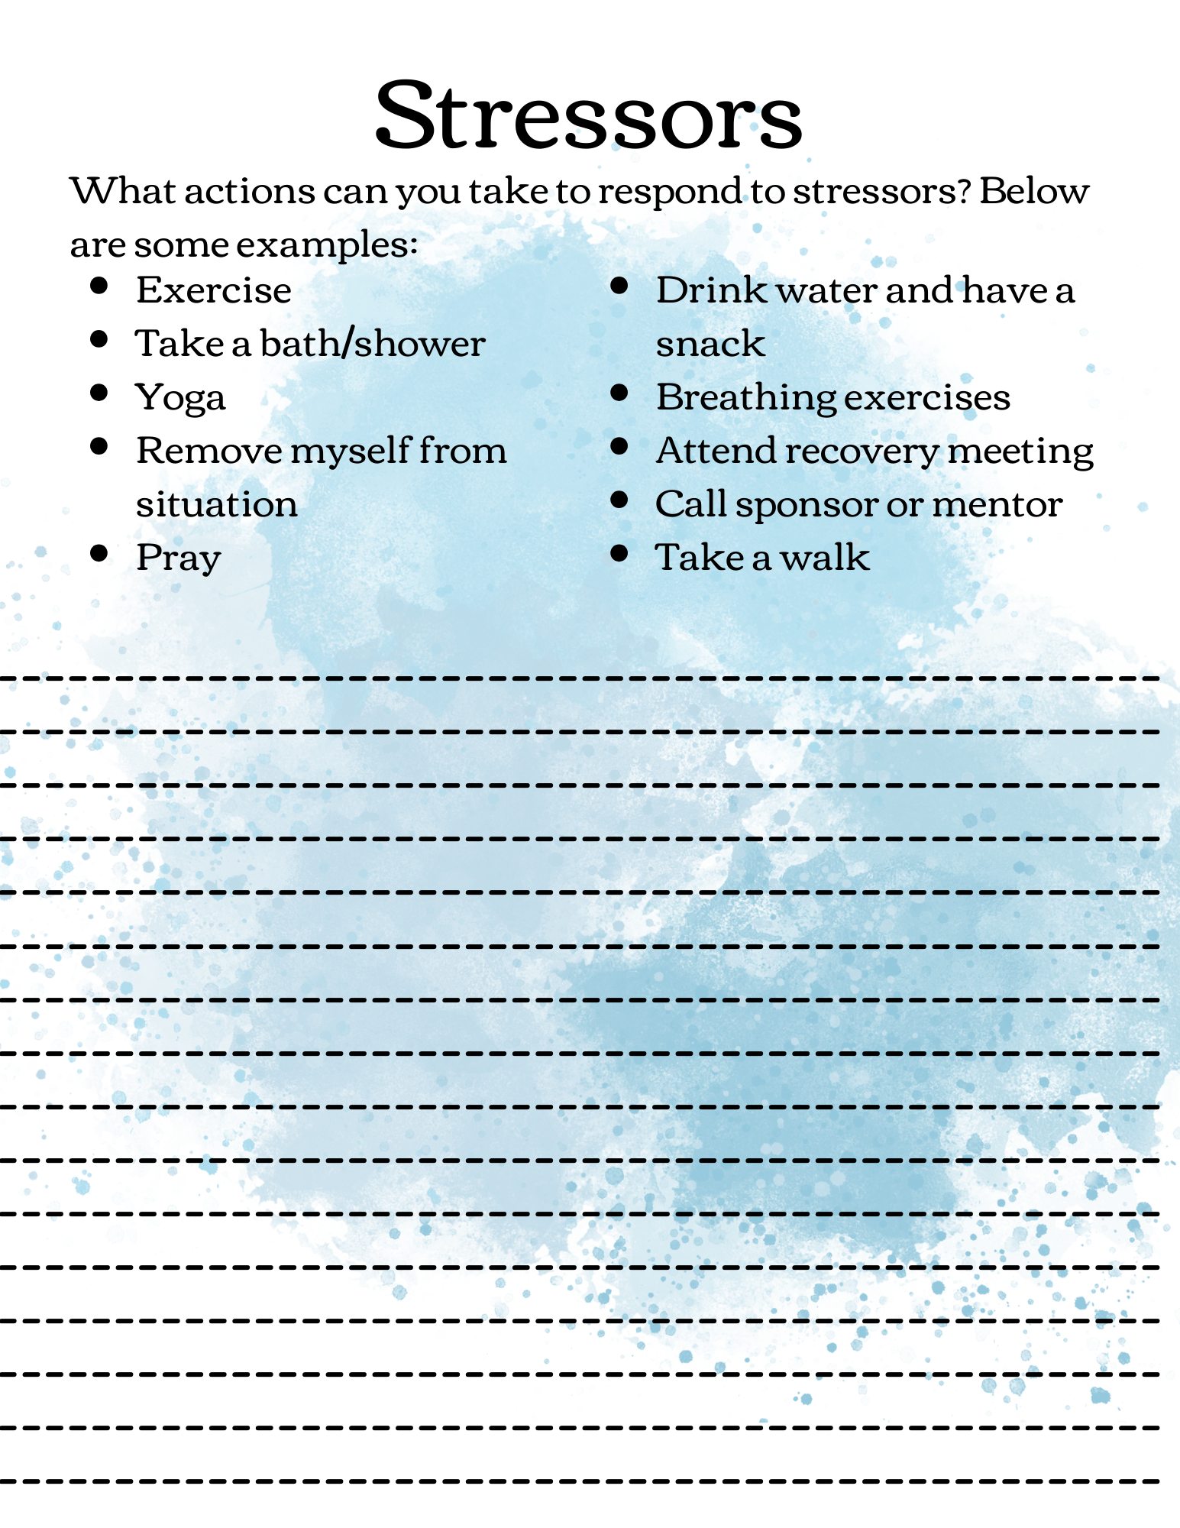

Slide 39
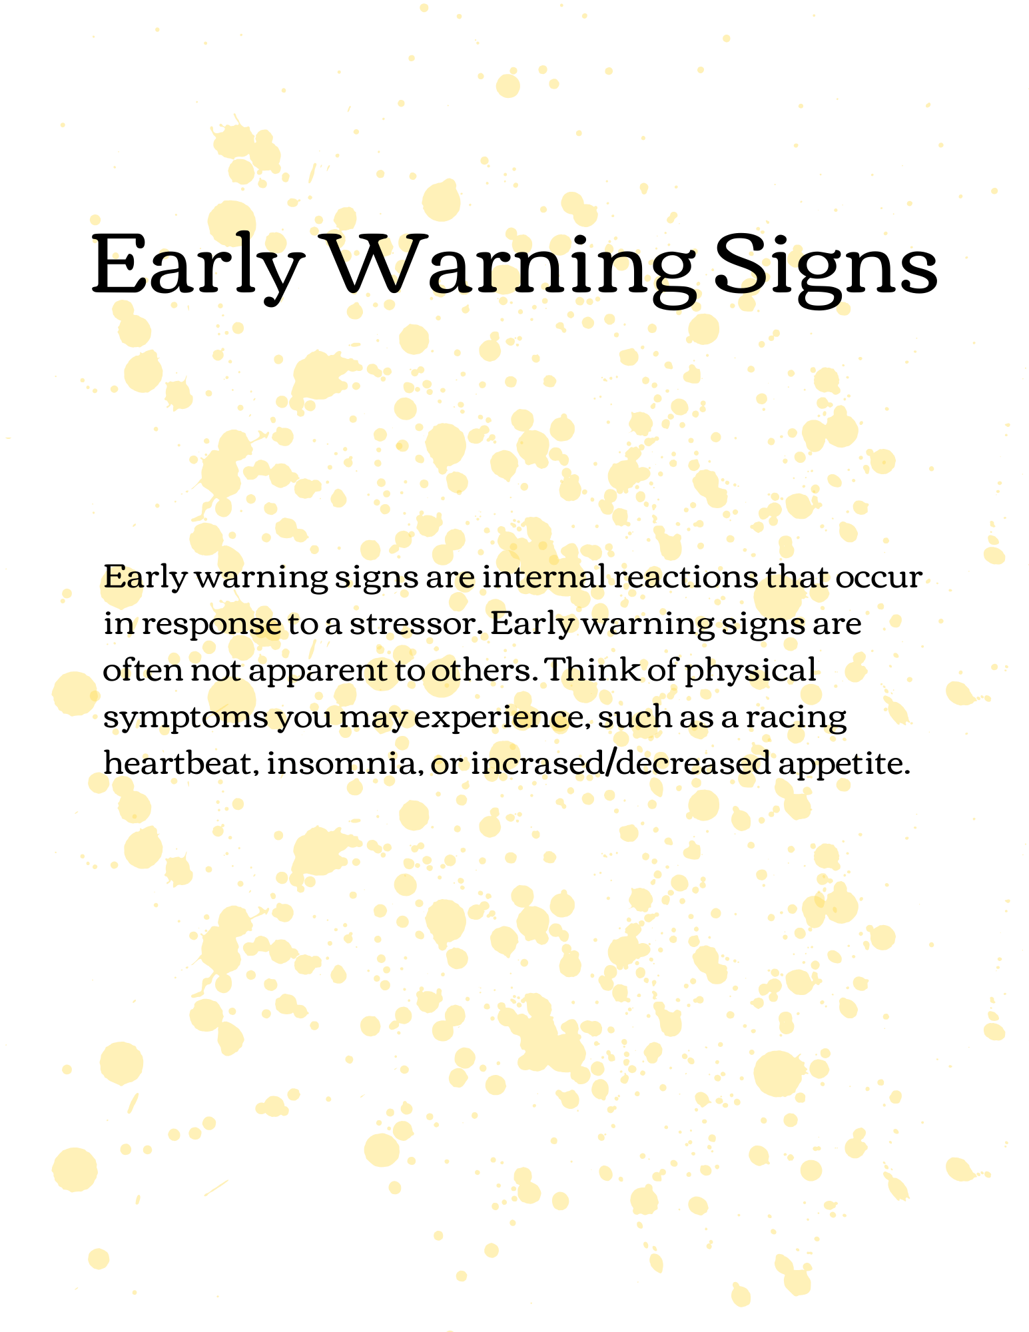

Slide 40
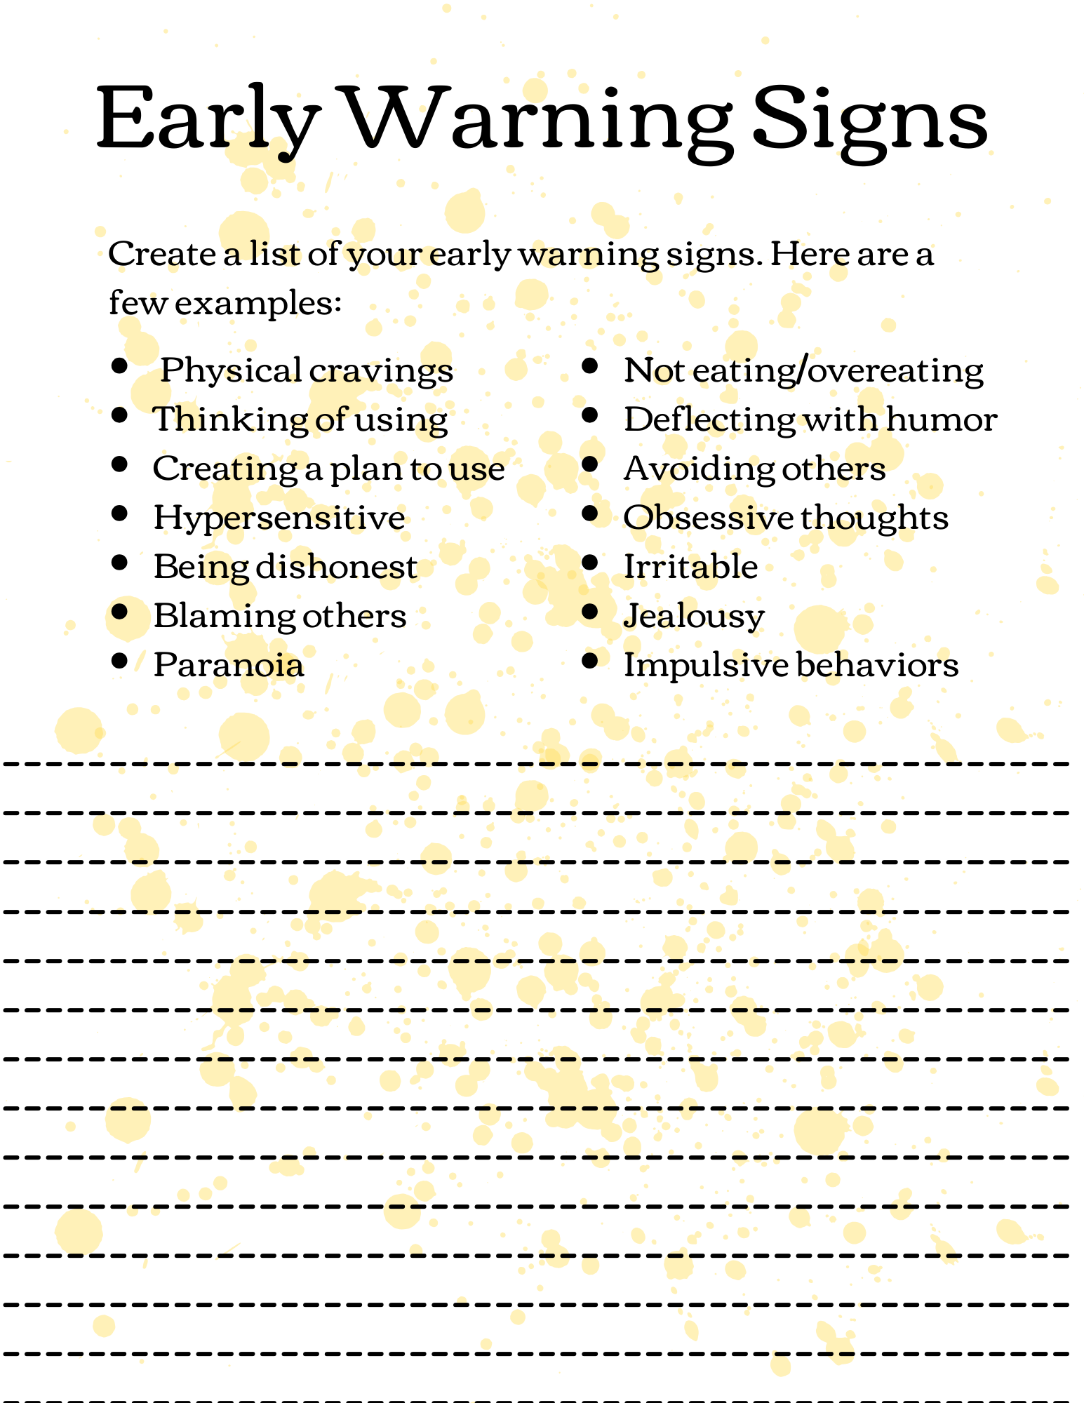

Slide 41
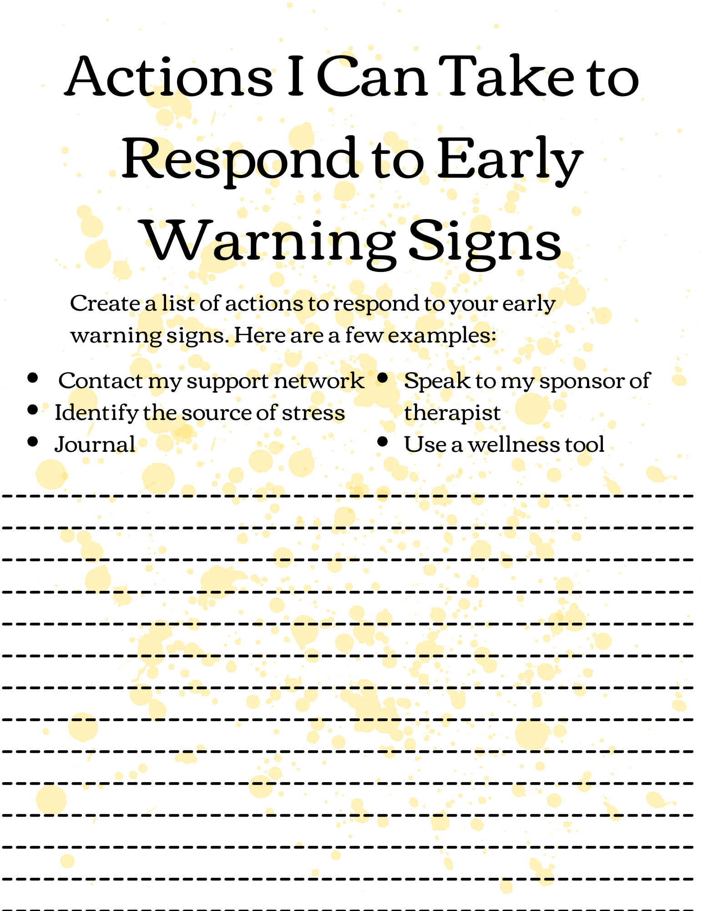

Slide 42
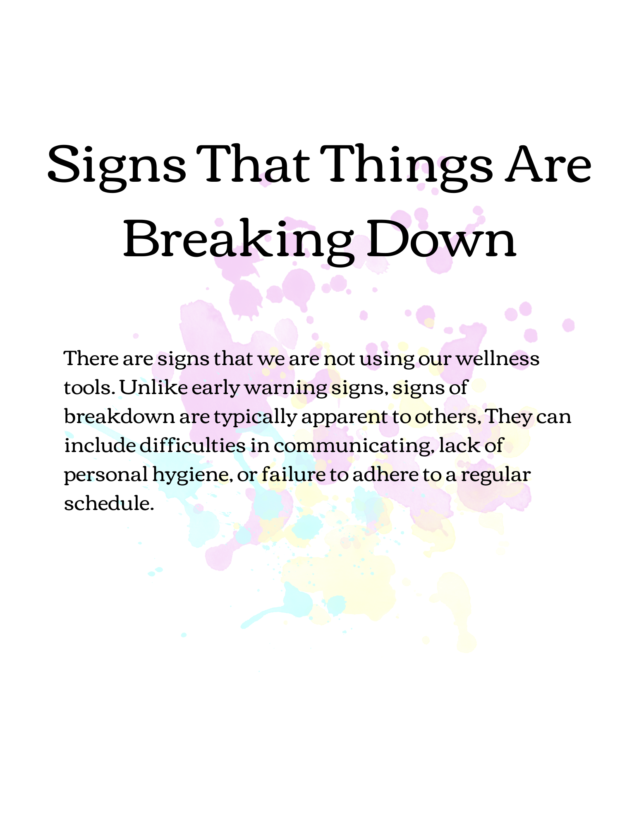

Slide 43
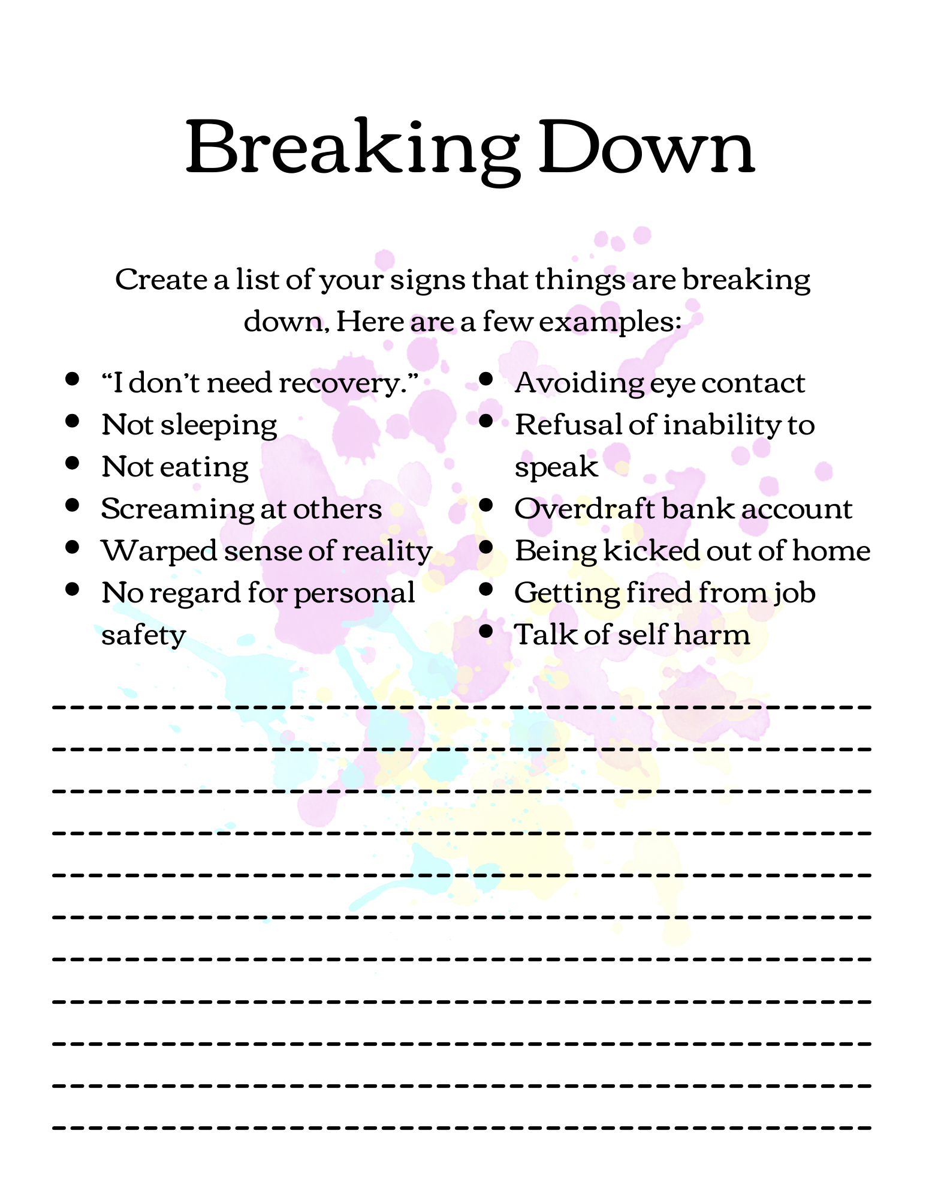

Slide 44
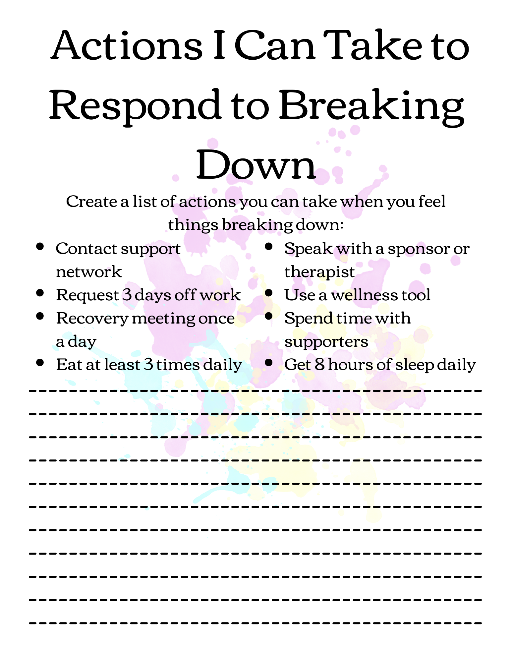

Slide 45
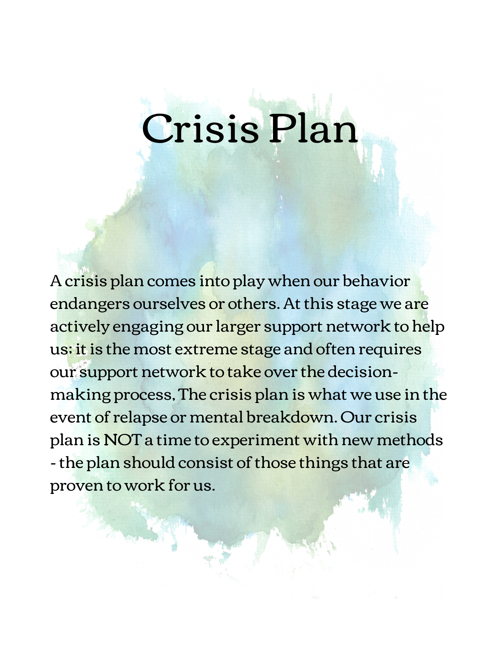

Slide 46
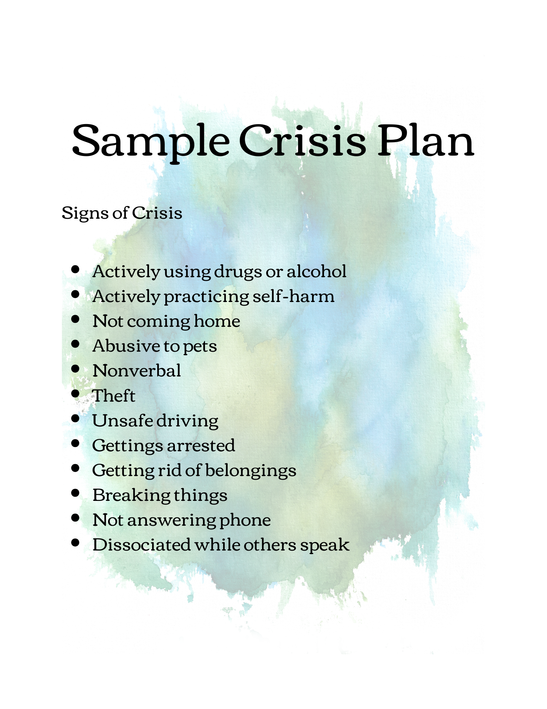

Slide 47
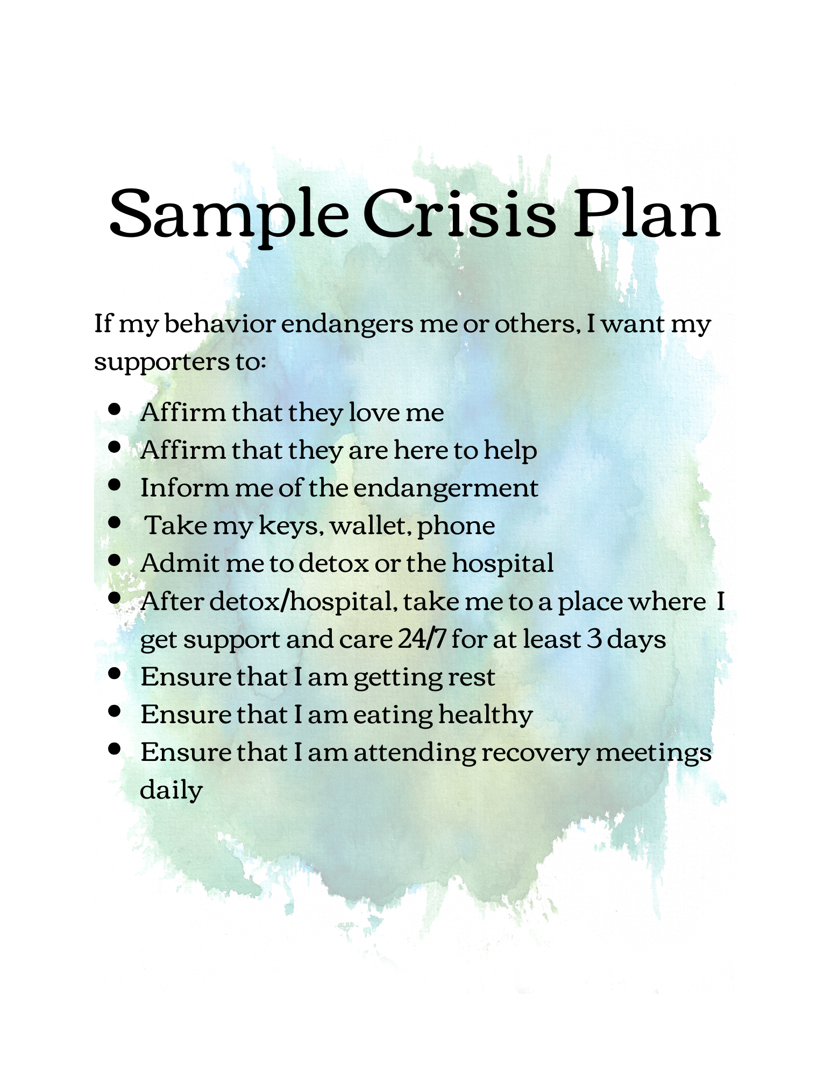

Slide 48
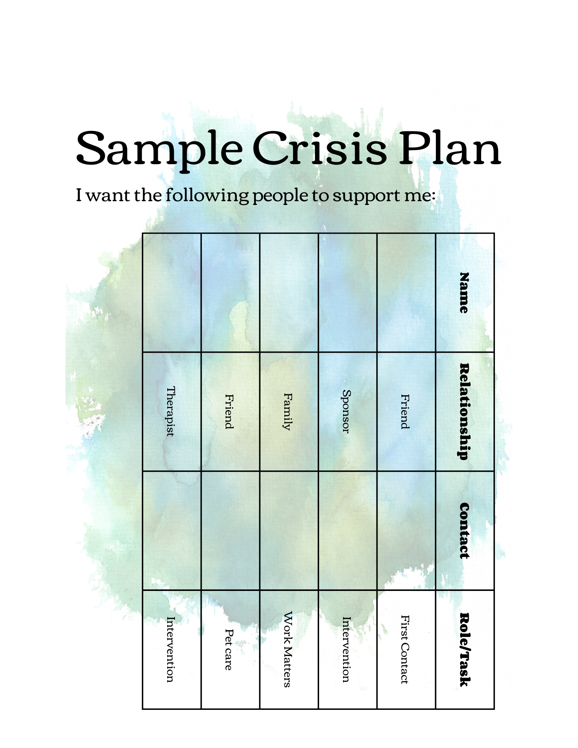

Slide 50
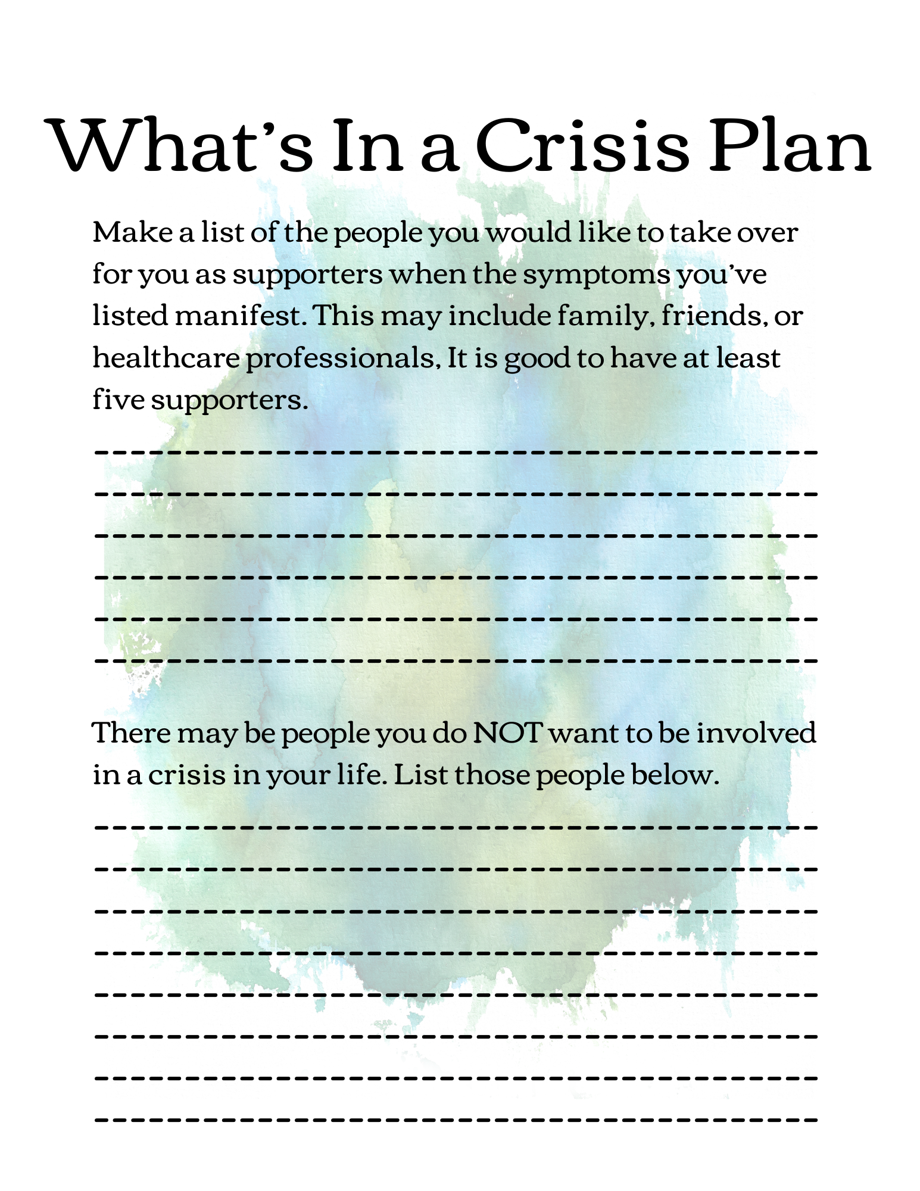

Slide 51
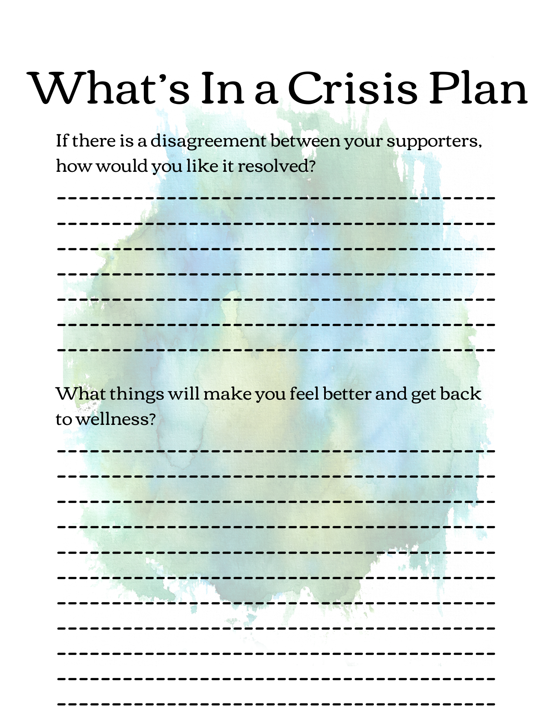

Slide 52
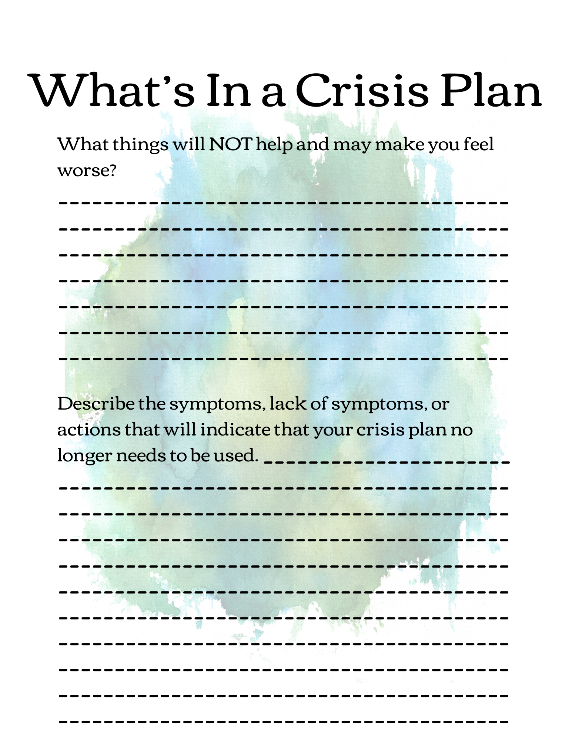

Slide 53
Progressive Muscle Relaxation

Slide 54
Leaves on a Stream
Stress is a big contributor and can exacerbate the effects of mental illness on a person. It is crucial to learn how to manage stress. This could include things such as meditation, time management, organizational skills, support systems, or more. We are going to walk through a few exercises that can be done to relax.​
First is a mindfulness activity called “Leaves on a Stream.” This approach allows you to come to terms with difficult thoughts or emotions. By using cognitive diffusion, which forms space from thoughts and feelings to decrease their influence on us. It teaches us to look at thoughts rather than from them – let thoughts come and go rather than hold on to them.​
Visualize yourself near a stream. Whatever thoughts enter your mind, you will imagine putting them on a leaf, and observing them drift away.​
Find a quiet spot, with no interruptions​
Sit or lie down in a comfortable position​
Shut your eyes​
Start taking deep, slow breaths​
Now, visualize yourself next to a stream – it can be any stream, but use all your senses to visualize the stream and its surroundings – the sound of the water, the bodily sensations, the smells, and anything that comes to mind.​
Your goal is to focus on the stream. When distractions penetrate your mind, take a moment to acknowledge them without judgment.​
After taking a moment to monitor the thought or emotion, refocus on the stream. Put your thought on a leaf. You can picture yourself writing it on the leaf or tying it to the stem. Place the leaf in the water and watch it float down the stream until it disappears.​
Continue visualizing the stream, thoroughly observing and freeing any thoughts that enter your mind. You can set a timer for 10-15 minutes to know when the exercise is over.​

Slide 55
Hydration
About 60% of your body weight is made of water. You need it for every single body function. It flushes toxins from your organs, carries nutrients to your cells, cushions your joints, and helps you digest food. If you don’t get enough water, you can become dehydrated. Severe cases of dehydration can cause dizziness, confusion, and even seizures. We’ve all heard that eight glasses of water each day is best. But the truth is that each person’s daily water intake varies. But there are some basic guidelines:​
For men, the Institute of Medicine (IOM) recommends 13 cups (about 3 liters) of fluid daily.​
For women, they suggest 9 cups (a little over 2 liters) of fluid each day. Pregnant women should drink about 10 cups of water daily. Those who breastfeed need about 12 cups.​
Benefits of drinking water regularly:​
Improved physical performance: During physical activities, your body uses a lot of water, and you must rehydrate it to keep from causing your body harm and allowing it to perform better. Proper hydration can reduce fatigue, improve endurance, lower your maximum heart rate, and help to alleviate soreness after exercise.​
Help losing weight: Drinking water helps to fill you up, and if you are on a plan to lose weight, many studies recommend drinking 8 ounces of water before each meal.

Slide 56
Exercise
People with severe mental disorders, such as psychotic disorders, bipolar disorders, and depression, spend an average of 7.8 hours in sedentary behavior per day, being significantly more sedentary than age- and gender-matched peers. They also spend an average of 38 minutes daily in moderate to vigorous physical activity, significantly lower than peers. Moreover, they are 50% less likely to meet physical activity guidelines. Among individuals with mental disorders, lower physical activity levels are associated with being male, being single, being unemployed, having fewer years of education, having higher body mass index (BMI), having longer illness duration, antidepressant and antipsychotic medication use, and having a lower cardiorespiratory fitness. People with schizophrenia were the least active, while people with bipolar disorder were the most physically active. However, people with bipolar disorder are the ones reporting higher levels of sedentary behavior.​
To benefit from exercise, it needs to be a regular part of your daily routine. It burns away chemicals like cortisol and norepinephrine that causes stress. At the same time, it releases endorphins, which can cause feeling of elation or well-being.​

Slide 57
Limit Alcohol, Caffeine, and Nicotine
Alcohol, nicotine, and caffeine are the most widely consumed psychotropic drugs worldwide. Individuals largely consume them, but their use is even more frequent in psychiatric patients, Thus, patients with schizophrenia tend to abuse all three substances. All three substances can Induce dependence. Conversely, patients presenting with various mental disorders may be more prone than the general population to use or abuse these three common substances. Thus, patients with bipolar depression are more likely to abuse alcohol at certain times In the course of their Illness. Patients with schizophrenia have high rates of consumption of all three substances, which they use to relieve dysphoria.​
Some side effects of caffeine : Anxiety, insomnia, digestive issues, muscle breakdown, addiction, high blood pressure, and rapid hear rate​
Some side effects of alcohol: High blood pressure, heart disease, stroke, liver disease, and several varieties of cancer. In addition, it can also cause learning and memory problems, including dementia.​
Some side effects of nicotine: It adversely affects many organs including cardiovascular, respiratory, renal and reproductive systems. ​
​

Slide 58
Core Competencies and Objectives
Core Competency 3 – Stages in the Recovery Process
Participants will be able to identify the five stages of the recovery process, what people experience, the dangers associated with each stage, and the role of the Peer Support Specialist.
Participants will understand the history of mental health diagnosis and the change in perception of stabilization and recovery.
Participants will think and convey in a systematic way the nuances between APSS and the role of traditional staff members.
Participants will understand the different behavioral health diagnoses by the Diagnostic and Statistical Manual of Mental Health Disorders (DSM) and identify the stages of change.
Participants will understand the four major dimensions that support recovery and identify the ten guiding principles of recovery.
Participants will discuss common themes of spirituality and the importance of spirituality in wellness.
Participants will understand what Evidence Based Practices (EBP) is, how APSS relates to EBP, and other EBPs related to behavioral health.
“Knowing is not enough; we must apply.”
- Johann Wolfgang van Goethe

Slide 59
Five Stages in the Recovery Process

Slide 60
Stage 1: Impact of Illness
What people are experiencing:​
There will be times they are overwhelmed but the disabling power of the illness. They may struggle with the symptoms, the behavior brought on by the symptoms, and the ramifications of this behavior. It may be difficult to even function in this stage. The illness is central focus of their life, and the impact of the illness is the dominant experience in their life. They may be battling depression that keeps them from getting out of bed, due to past behaviors, they may have cut themselves off from former significant supportive relationships. Ot the symptoms and behavior may be under control, but they are so overmedicated that they cannot function. People may be overwhelmed with the stigma or how their identity is begin redefined or by what is happening to their self-image.​
Many people experience the onset of symptoms, the resulting behavior and the loss often incurred as a ‘catastrophic shattering of their world, hopes and dreams’ to use Patricia Deegan’s words. People use a variety of words to describe this time in their lives – confusion, shame, loss, shattered, denial, bizarre, not in control, looking for answers. As consumers have talked about this time, there are a number of common themes. Some experience this as a time of ‘living two lives.’ At work they are ‘functioning’ or ‘going through the steps of living’. But experience no joy, meaning or fulfillment. No life outside of work. They go home and crash. They spend a lot of time alone, in bed. They have no energy. They know that something is wrong but will not or are not able to seek help. They try to hide what is going on from others. For some this ‘living two lives’ goes on for years. For others their life becomes chaotic, and they often talk about feeling that they are not in control. They don’t understand what is happening and often turn to drugs and alcohol for some relief. They experience a lot of loss. They burn a lot of bridges. There is a lot of denial that anything is wrong. Some talk about feeling that they had gone someplace from which they couldn’t come back. ​

Slide 61
Stage 1: Impact of Illness
Dangers for people in this stage:​
The biggest danger is that the person will redefine themselves in mental illness terminology that will automatically limit their future. If a person is unable to see themselves as anything other than a Mental Illness patient, they will be unable to successfully maneuver the challenges and opportunities that arise in the lives of people as we go along. It is a question of identity – How am I going to define who I am and what I can do on the other side of this experience? This limitation of self reduces their hopes, dreams, and expectations.​
Role of the Seer Support:​
The primary role of services at this time is to decrease the emotional distress by reducing the symptoms and communicating that there is life after diagnoses. The peer support will be a realistic cheerleader – life is hard now, but it can and will get better as you move down the pathway. Reminding the client that this is stage one, and the world will look differently as they move forwards.​

Slide 62
Stage 2: Life is Limited
What people are experiencing:​
There will be times when a person has given up and given in to the disabling power of illness. The person doesn’t like their live, but believe it is the best it will ever be. Two things happen at this stage, there are major changes in how the person views themselves, and there are major changes in the way others see and relate to the person.​
They may begin to feel a sense of hopelessness, helplessness, uselessness, being frightened, ashamed, or self-pity.​
The disability takes on a life of its own, unrelated to the symptoms. The person may feel an inability to do various things, even though they are not “symptomatic”. ​
What does it mean to have given in to the disabling power of the diagnosis? In this stage you believe that you are the diagnosis. The diagnosis has taken over your life and has become the way you define yourself. The diagnosis has become your identity. All of reality is viewed through the lens of the diagnosis and often negative prognosis about the illness, and you see no possibility of having a different life.​
If you believe that there is nothing you can do that is going to make your life the way you want it to be, what do you do? You do nothing. And in doing nothing, you turn your life over to some one or some thing that you hope will make a difference. ​

Slide 63
Stage 2: Life is Limited
Dangers for people in this stage:​
The biggest danger is that the person will resign to this life and refuse to acknowledge that there is anything different they can do that will make a difference in their life.​
A visual image for this stage is a person sitting in a lazy-boy chair in front of a TV with a remote in their other. They are gazing at the TV. There is nothing on the TV but static. There is a sense of giving up or giving into a life without hope of anything ever being any different. “This is my life. I don’t like it, but it is the only life I have. Just accept it”.​
The person may become so comfortable with this attitude that they will be unable to see the possibility of moving past this comfort zone. They may refuse to acknowledge that there is anything they can do to create the life they want.​
Role of the Seer Support:​
The primary role of services at this time is to instill hope, a sense of possibility, and to rebuild a positive self-image. Your role is to talk to them off the ledge – you can do this by talking about the small steps they can take, talking about your own steps, the number of people that have gone before them, and the steps they have already taken.​

Slide 64
Stage 3: Change is Possible
What people are experiencing:​
People are beginning to believe there has to be more to life than what they are currently experiencing and are beginning to believe their life can be different. They are questioning the disabling power of the illness. This is more about the awareness of possibility than taking action. They may not know what they can do just yet, but they know they can do more than what their life has been up to this point.​
This is the stage where the demeanor appears to have a small crack – they start thinking they can do things instead of they can’t.​
As Patricia Deegan says, “Maybe my life does not have to be all of this self-pity, darkness and despair.” The person is not sure what the future holds, but they are beginning to believe that it may be a little brighter than they had been telling themself. And there may be something they can do that will make a difference.​
Often there is a lot of talk at this stage about various possibilities, but little real action. Maybe I could do this. The person gets right up to the edge of doing something, then chickens out. This may happen many times around many different perceived possibilities.

Slide 65
Stage 3: Change is Possible
Dangers for people in this stage:​
The biggest danger is that the person will be afraid to or discouraged from taking the necessary risks and remain in the “Life is Limited” stage.​
This stage is about the questions of risk. When I sense that there is something I can do that may help me improve the quality of my life, how am I going to relate to the risks that might be involved in making that change? ​
The danger is that the person will not take their risks required to move on with their life. They may talk themselves out of doing what they say they want to do.​
Role of the Seer Support:​
The primary role of services at this time is to help the person see that they are not so limited by the illness, and in order to move on, they will need to take some risks.​
Keeping in mind that there are internal pressures (Fear of relapsing) and external pressures (You are not ready) that may be coming from all sides and converge to talk the person out things they really want to do – the uncertainty of leaving a comfort zone cannot be downplayed. You will need to help by discussing the pros and cons of actions, helping them to work through the risks and assuring them that you are there to help.​

Slide 66
Stage 4: Commitment to Change
What people are experiencing:​
The person is challenging the disabling power of the illness, They believe there are possibilities, but are not sure what they are and what to do. They may be willing to explore what it will take to make some changes. This is because their belief about their own situation has begun to shift. Often people talk about this shift as ‘I was sick and tired of being so sick and tired. I could not go on. I had to do something.’​
They do not usually have a plan of action that is moving them toward a long term, or even short-term goal. They just feel like they have to do something and cannot tolerate life as it is currently. The key is to do something that breaks the pattern of doing nothing.​
This stage may look like baby steps to outsiders, but it is actually about small triumphs and simple acts of courage.

Slide 67
Stage 4: Commitment to Change
Dangers for people in this stage:​
The biggest danger is that the person will not get all the supports they need to be successful, move out too quickly, not succeed and retreat into their comfort sone within the system.​
This stage is really about a question of support – when do I decide to take the risks, how will I get supports that I need to succeed?​
Many times, people may skip the preparation stage – they do not think enough through everything that is going to be required of them to not only make the change, but also to sustain it.​
Role of the Seer Support:​
The primary role of services at this time is to help the person take the initial steps by helping them to identify their strengths and needs in terms of skills, resources, and supports.​
You must help them develop a plan, and discuss the different aspects that the person will have to do to make the change, but also what it will take to maintain the change, what resources are available, some hurdles they may meet, etc.​

Slide 68
Stage 5: Action to Change
What people are experiencing:​
The person is moving beyond the disabling power of the illness, They have decided the direction they want to go in life and are willing to take more responsibility for their own decisions and actions. Life takes on a sense of direction. “I know what I want to do with my life.” There is a major shift in focus from the illness and its limitations to life and its possibilities. It is no longer acting to break the pattern of doing nothing. It is acting to move one in the direction they wants their life to go.​
The person starts taking actions that will move them towards their goal – or at least to begin to create the life that they want and will lessen their dependency on the mental health system.

Slide 69
Stage 5: Action to Change
Dangers for people in this stage:​
The biggest danger is that the person begins to question their abilities to take on all the responsibility involved in creating new relationships and roles outside of the system. The danger at this stated is held in the question of responsibility.​
Am I prepared to take on the responsibilities necessary to live in the larger community? Do I have the tools to survive? Will I be able to live without the supports I have been receiving?​
Role of the Seer Support:​
The primary role of services at this time is to equip them with the necessary skills, resources, and supports so they can trust in their own decision-making ability and take more responsibility for their own life.​
Like most things in life, there is not just one path to recovery. Each person’s experience will likely be different from their friends, even if the diagnoses is the same. Recovery is as unique to everyone as their fingerprint and should be treated as such. Just because someone is not following the same path you took, does not mean that their path will not work, nor does it mean one way is better than another.​
​
People will have up days and down, so your role is to guide and talk to them about moving forward.​

Slide 70
Courtney Harding’s Findings
RESEARCH FINDINGS RELATED TO MENTAL HEALTH RECOVERY
Recovery is not the exception to the rule but is the rule itself. Recovery is not only possible, but also probable.
Nine studies have followed up with over 2000 people over a period averaging 20 years found that an average of 66% had recovered to the point that a nonprofessional person would not be able to discern they had a mental illness (see
charts attached.) Characteristics of the “recovered” person included:
Making their own decisions
Having a fulfilling network of friends
Having a major social role other than consumer
Using emotional distress as an opportunity for growth
Primary supports outside MH system
What does research say about what type of mental health service is helpful?
Courtney Harding, PhD, compared 2 groups of people who had been diagnosed with severe and persistent mental illness and who were in the backwards of state mental hospitals. One group came from Vermont, which has a progressive
program of psychiatric rehabilitation focused on recovery and the other group came from Maine. The people studied in Maine had the same identifying characteristics at the start but then received mental health services as usual, case management and a focus on maintenance and stability.

Slide 71
Courtney Harding’s Findings
Vermont:
269 patients from back wards of Vermont State Hospital in the 1950’s
97% of the Vermont group was located and assessed during the follow-up study in the early 1980’s
Maine:
Subjects were matched by age, gender, diagnosis, and chronicity from the back wards of the Augusta State Hospital in Maine.
94% of the Maine group was located and assessed during the follow-up study in the early 1980’s
Dr. Harding’s definition of recovery was relatively narrow and has four criteria:
having a social life indistinguishable from your neighbor
holding a job for pay or volunteering
no longer experienced symptoms of mental illness
no longer taking medication

Slide 72
Courtney Harding’s Findings
Vermont findings?
Dr. Harding’s data of the recovery-oriented system in Vermont pointed to significant improvement in 62% to 68% of people studied. Dr. Harding’s data are all the more powerful because she was studying the bottom 19% in the functional
hierarchy in a large state hospital. Some of the people in her study had regressed to speaking in animal-like sounds. Most had been in the institution for 10 or so years, many had been in and out repeatedly. The Vermont and Maine group was the least functional ever studied in world literature on schizophrenia.
Nevertheless, of this bottom 19%, 62% to 68% fully recovered or significantly improved. Half of the cohort of 62% fully recovered meeting all of Dr. Harding’s recovery criteria and half met three out of four criteria, usually continuing to take
medications while meeting the other criteria.
Maine findings?
In the companion study to her Vermont study, Dr. Harding studied a system in Maine oriented to maintenance instead of recovery . Patients were considered incapable of accomplishing anything like holding jobs or volunteering. They were expected to be in and out of the hospital for the rest of their lives and basically live as totally disabled. In this system, in spite of the adverse expectations, people recovered or significantly improved at a rate of 47%. Vermont’s 62% to
68% recovery rate was significantly better. Those who had been studied in Vermont were significantly more likely to have lower symptoms and to work or volunteer. This endorses the healing effects of meaningful activity, whichever the individual chooses to pursue.

Slide 73
Courtney Harding’s Findings
Who will fully recover and who will not?
Multiple analyses have looked for a variable that predicts who will and who will not recover. Significantly, to date, none has been found. Since the mental health system cannot predict who will and who will not recover…each and every person must be assumed to be the one who will recover. In the process, all persons will recover a position of authority over their own experience and be accorded the respect to choose their own path of recovery.
Understanding the Work of Harding, Davidson, and Spaniol (2005) on Mental Health
Introduction: Harding, Davidson, and Spaniol (2005) conducted groundbreaking research that significantly contributed to our understanding of mental health and
recovery. Their work sheds light on key principles and practices that have since influenced mental health policy, treatment approaches, and community support
systems.
Key Concepts:
1. Recovery-Oriented Care:
Harding, Davidson, and Spaniol emphasized the importance of adopting a recovery-oriented approach to mental health care.
They advocated for personalized treatment plans that focus on individuals' strengths, goals, and aspirations rather than solely managing symptoms.

Slide 74
Courtney Harding’s Findings
2. Consumer Empowerment:
The researchers highlighted the need for individuals with mental illness to be actively involved in their treatment and decision-making processes.
Empowering consumers to take control of their recovery journey and participate in treatment planning was a central tenet of their work.
3. Community Integration:
Harding, Davidson, and Spaniol emphasized the significance of community integration and social support in promoting mental health recovery.
They advocated for the development of supportive housing, employment opportunities, and social networks to facilitate individuals' reintegration into society.
4. Holistic Wellness:
Their research emphasized the importance of addressing not only psychiatric symptoms but also the broader aspects of wellness, including physical health, social connections, and meaningful activities.
Impact and Implications:
1. Policy Reform:
The work of Harding, Davidson, and Spaniol has influenced mental health policy at local, national, and international levels.
Their research has contributed to the adoption of recovery-oriented principles in mental health systems and the development of supportive housing and community-based services.

Slide 75
Courtney Harding’s Findings
2. Clinical Practice:
Mental health professionals have integrated the principles of recovery-oriented care into clinical practice, leading to more person-centered and collaborative approaches to treatment.
Consumer empowerment and community integration are now core components of many mental health treatment programs.
3. Education and Training:
Their research has informed the education and training of mental health professionals, emphasizing the importance of cultural competence, trauma-informed care, and consumer-driven practices.
Conclusion: Harding, Davidson, and Spaniol's work has had a profound impact on mental health care, promoting recovery, empowerment, and community integration for
individuals living with mental illness. Their research continues to inspire and inform efforts to create more inclusive, supportive, and effective mental health systems
worldwide

Slide 76
Patricia E. Deegan Ph.D.
Recovery: The Lived Experience of Rehabilitation
Patricia E. Deegan Ph.D. is an independent consultant who specializes in researching and lecturing on the topic of recovery and the empowerment of people diagnosed with
mental illness. She is the creator of CommonGround, a web application to support shared decision making in the psychopharmacology consultation. It won the American
Psychiatric Association's, Psychiatric Services Gold Achievement Award, the 2013 Scattergood Foundation Innovation Award in behavioral health and was a finalist in an international competition for Patient Empowerment by the Ashoka Changemakers Foundation and was recognized by the Agency for Healthcare Research and Quality as
a practice innovation. Pat is an activist in the disability rights movement and has lived her own journey of recovery after being diagnosed with schizophrenia as a teenager. She is an Adjunct Professor at Dartmouth College School of Medicine and at Boston University, Sargent College of Health and Rehabilitation Sciences.
Abstract: This paper distinguishes between recovery and rehabilitation. Psychiatrically disabled adults do not “get rehabilitated” but rather they recover a new and valued
sense of self and of purpose. Through the recovery process, they become active and responsible participants in their own rehabilitation project. The experiences of recovery
as lived by a physically disabled man and a psychiatrically disabled woman are discussed. Recommendations for creating rehabilitation environments that facilitate the
recovery process are also given

Slide 77
Patricia E. Deegan Ph.D.
The application of rehabilitation approaches and technologies to psychiatrically disabled adults is a relatively new and exciting development in our field. The discovery and
application of rehabilitation models allow us to think about this population in new and exciting ways. Of significance is the fact that from the perspective of the rehabilitation
approach, it is no longer necessary to isolate the psychiatrically disabled as totally different from other groups of persons with disabilities. Today, artificial boundaries
between groups of disabled persons can be bridged through the understanding that most disabled people share the same fundamental needs and aspirations: The need is
to meet the challenge of the disability and to re-establish a new and valued sense of integrity and propose within and beyond the limits of the disability; the aspiration is to
live, work, and love in a community in which one makes a significant contribution.
It is important to understand that persons with a disability do not “get rehabilitated” in the sense that cars “get tuned up” or televisions “get repaired.” Disabled persons are
not passive recipients of rehabilitation services. Rather, they experience themselves as recovering a new sense of self and of purpose within and beyond the limits of the disability. This distinction between rehabilitation and recovery is important.
Rehabilitation refers to the services and technologies that are made available to disabled persons so that they might learn to adapt to their world. Recovery refers to the lived or real-life experience of persons as they accept and overcome the challenge of a disability. We might say that rehabilitation refers to the “world pole” and recovery refers to the “self-pole” of the same phenomenon.

Slide 78
Patricia E. Deegan Ph.D.
The recovery process is the foundation upon which rehabilitation services build. This is most evidenced in the simple observation that we can make the finest and most
advanced rehabilitation services available to the psychiatrically disabled and still fail to help them. Something more than just “good services” is needed, e.g., the person must get out of bed, shake off the mind-numbing exhaustion of the neuroleptics, get dressed, overcome the fear of the crowded and unfriendly bus to arrive at the program, and face the fear of failure in the rehabilitation program. In essence, disabled persons must be active and courageous participants in their own rehabilitation project or that project will fail. It is through the process of recovery that disabled persons become active and courageous participants in their own rehabilitation project.
We see then that recovery is an important and fundamental phenomenon upon which rehabilitation efforts depend. It is therefore surprising that very little has been written in
our professional and scientific journals regarding it. Perhaps the phenomenon is elusive precisely because it is so fundamental. Perhaps it is because the recovery process
cannot be completely described with traditional scientific, psychiatric, or psychological language. Although the phenomenon will not fit neatly into natural scientific paradigms, those of us who have been disabled know that recovery is real because we have lived it. At a recent conference that brought together persons with diverse disabilities, I had the pleasure of talking with a man who was paraplegic. We shared our stories of recovery.

Slide 79
Patricia E. Deegan Ph.D.
The Experience of Recovery
At a young age we had both experienced a catastrophic shattering of our world, hopes, and dreams. He had broken his neck and was paralyzed, and I was diagnosed as being
schizophrenic. We recalled the impact of those first days following the onset of our disabilities. He was an athlete and dreamed of becoming a professional in the sports world. I was a high school athlete and had applied to college to become a gym teacher. Just days earlier we knew ourselves as young people with exciting futures, and then everything collapsed around us. As teenagers, we were told that we had an incurable malady and that we would be “sick” or “disabled” for the rest of our lives. We were told that if we continued with recommended treatments and therapies, we could learn to
“adjust” and “cope” from day to day.
Needless to say, we didn’t believe our doctors and social workers. In fact, we adamantly denied and raged against these bleak prophesies for our lives. We felt it was all just a
mistake, a bad dream, a temporary setback in our lives. We just knew that in a week or two, things would get back to normal again. We felt our teenage world was still there,
just waiting for us to return to it. Our denial was an important stage in our recovery. It was a normal reaction to an overwhelming situation. It was our way of surviving those
first awful months.
The weeks passed us by, but we did not get better. It became harder and harder to believe we would ever be the same again. What initially had seemed like a fleeting bad dream, transformed into a deepening nightmare from which we could not awake. We felt like ships floating on a black sea

Slide 80
Patricia E. Deegan Ph.D.
with no course or bearings. We found ourselves drifting farther and farther away from the young, carefree people we had been. He lay horizontal and in traction while his friends were selected to play ball for prestigious colleges. I stood drugged and stiff in the hallways of a mental hospital while my classmates went off to their first year of college.
We experienced time as a betrayer. Time did not heal us. Our pasts deserted us, and we could not return to who we had been. Our futures appeared to us to be barren, lifeless places in which no dream could be planted and grow into a reality. As for the present, it was a numbing succession of meaningless days and nights in a world in which we had
no place, no use, and no reason to be. Boredom and wishfulness became our only refuge (Knowles, 1986).
Our denial gave way to despair and anguish. We both gave up. Giving up was a solution for us. It numbed the pain of our despair because we stopped asking, “Why and how will I go on?” (Harrison, 1984). Giving up meant that for 14 years, he sat in the day rooms of institutions gazing at soap operas, watching others live their lives. For months I sat in a chair in my family’s living room, smoking cigarettes and waiting until it was 8:00 p.m. so I could go back to bed. At this time, even the simplest of tasks were overwhelming. I remember being asked to come into the kitchen to help knead some bread dough. I got up, went into the kitchen, and looked at the dough for what seemed an eternity. Then I walked back to my chair and wept. The task seemed overwhelming
to me. Later I learned the reason for this: when one lives without hope, (when one has given up) the willingness to “do” is paralyzed as well.

Slide 81
Patricia E. Deegan Ph.D.
All of us who have experienced catastrophic illness and disability know this experience of anguish and despair. It is living in darkness without hope, without a past or future. It is
self-pity. It is hatred of everything that is good and life giving. It is rage turned inward. It is a wound with no mouth, a wound that is so deep that no cry can emanate from it.
Anguish is a death from which there appears to be no resurrection. It is inertia which paralyzes the will to do and to accomplish because there is no hope.
It is being truly disabled, not by a disease or injury, but by despair. This part of the recovery process is a dark night in which even God was felt to have abandoned us. For
some of us, this dark night lasts moments, days, or months. For others, it lasts years. For others, the despair and anguish may never end.
Neither the paralyzed man nor I could remember a specific moment when the small and fragile flame of hope and courage illuminated the darkness of our despair. We do
remember that even when we had given up, there were those who loved us and did not give up. They did not abandon us. They were powerless to change us, and they could not make us better. They could not climb this mountain for us, but they were willing to suffer with us. They did not overwhelm us with their optimistic plans for our futures, but they remained hopeful despite the odds. Their love for us was like a constant invitation, calling us forth to be something more than all of this self-pity and despair. The miracle was that gradually the paralyzed man and I began to hear and respond to this loving invitation.

Slide 82
Patricia E. Deegan Ph.D.
For 14 years, the paralyzed man slouched in front of the television in the hell of his own despair and anguish. For months I sat and smoked cigarettes until it was time to
collapse back into a drugged and dreamless sleep. But one day, something changed in us. A tiny, fragile spark of hope appeared and promised that there could be something
more than all of this darkness. This is the third phase of recovery. This is the mystery. This is the grace. This is the birth of hope called forth by the possibility of being loved.
All of the polemic and technology of psychiatry, psychology, social work, and science cannot account for this phenomenon of hope. But those of us who have recovered know that this grace is real. We lived it. It is our shared secret.
It is important to understand that for most of us recovery is not a sudden conversion experience. Hope does not come to us as a sudden bolt of lightning that jolts us into a whole new way of being. Hope is the turning point that must quickly be followed by the willingness to act. The paralyzed man and I began in little ways, with small triumphs and simple acts of courage: He shaved, he attempted to read a book, and he talked with a counselor; I rode in the car, I shopped on Wednesdays, and I talked to a friend for a few minutes. He applied for benefits, he got a van and learned to drive; I took responsibility for my medications, took a part-time job, and had my own money. He went to college so he could work professionally with other disabled people; I went to school to become a psychologist so I could work with disabled people. One day at a time, with multiple setbacks, we rebuilt our lives. We rebuilt our lives on the three cornerstones of recovery—hope, willingness, and responsible action. We learned to say: “I am hopeful,” “I am willing to try,” and “I discover that I can do” (Knowles, 1986). This is the process of recovery which is the ground from which springs effective use of rehabilitation services.

Slide 83
Patricia E. Deegan Ph.D.
Recovery does not refer to an end product or result. It does not mean that the paralyzed man and I were “cured.” In fact, our recovery is marked by an ever-deepening acceptance of our limitations. But now, rather than being an occasion for despair, we find that our personal limitations are the ground from which spring our own unique possibilities. This is the paradox of recovery, i.e., that in accepting what we cannot do or be, we begin to discover who we can be and what we can do.
Recovery does not refer to an absence of pain or struggle. Rather, recovery is marked by the transition from anguish to suffering. In anguish, the paralyzed man and I lived without hope. We experienced anguish as futile pain, pain that revolved in circles, pain that bore no possibility other than more pain, and pain that lead nowhere. However, when we became hopeful, our anguish was transformed into true suffering. True suffering is marked by an inner peace, i.e., although we still felt great pain, we also experienced a peace in knowing that this pain was leading us forward into a new future. A biologist who is handicapped with spina bifida captures this spirit of true suffering in recovery when she writes: “Suffering is peaceful. You know the pain may kill you, but it won’t destroy you. In a very risky way, you are safe.
For many of us who are disabled, recovery is a process, a way of life, an attitude, and a way of approaching the day’s challenges. It is not a perfectly linear process. At times our course is erratic, and we falter, slide back, re-group and start again. Our experience of recovery is similar to that described by the poet Roethke who was himself afflicted with major mental illness:

Slide 84
Patricia E. Deegan Ph.D.
Cuttings
…One nub of growth Nudges a sand-crumb loose, Pokes through a musty sheath Its pale tendrilous horn…
…This urge, wrestle, resurrection of dry sticks, Cut stems struggling to put down feet,
What saint strained so much,
Rose on such lopped limbs to a new life?
Recovery is the urge, the wrestle, and the resurrection. Recovery is a matter of rising on lopped limbs to a new life. As professionals, we would like nothing more than to somehow manufacture the spirit of recovery and give it to each of our program participants. But this is impossible. We cannot force recovery to happen in our rehabilitation programs. Essential aspects of the recovery process are a matter of grace
and, therefore, cannot be willed. However, we can create environments in which the recovery process can be nurtured like a tender and precious seedling.
Some of the principles for creating such environments in rehabilitation programs are given below.
Recovery in Rehabilitation Programs
As we have seen, recovery is not a linear process marked by successive accomplishments. The recovery process is more accurately described as a series of small beginnings and very small steps. To recover, psychiatrically disabled persons must be willing to try and fail, and try again. Too often, rehabilitation programs are structured in such a way as to work against this process of recovery. These programs tend to have rigid guidelines for acceptance. They tend to have linear program designs in which a person must enter at point “A”

Slide 85
Patricia E. Deegan Ph.D.
and move through a series of consecutive steps to arrive at point “B.” Failure at any point along the way will require that
participants return to entry level. Finally, some of these programs define failure in absolute terms, e.g., a program participant dropped from a vocational placement for failing to attend work for X number of days is simultaneously dropped from the program and must completely re-apply to the program when ready to accept the program’s rules and expectations. In all of these ways, the design and structure of rehabilitation programming can work against the process of recover.
Rehabilitation programs can be environments which nurture recovery if they are structured to embrace, and indeed expect, the approach/avoid, try/fail dynamic which is the recovery process. This means that rehabilitation programs must have very flexible entry criteria and easy accessibility. The design of rehabilitation programming must be nonlinear, i.e., with multiple points of entry and levels of entry into programming. The real challenge of rehabilitation programs is to create fail-proof program models. A program is fail-proof when participants are always able to come back, pick-up where
they left off and try again. In a fail-proof environment where one is welcomed, valued, and wanted, recovering persons can make the most effective use of rehabilitation services.
A second point regarding the establishment of rehabilitation environments conducive to the recovery process derives from the understanding that each person’s journey of recovery is unique. Of course, there are certain fundamental constituents of the process of recovery that are similar in all persons with a disability, e.g., the experience of despair and the transition to hope, willingness, and responsible action. However, disabled

Slide 86
Patricia E. Deegan Ph.D.
people are, above all, individuals and will find their own special formula for what promotes their recovery and what does not. Therefore, it is important to offer recovering persons a wide variety of rehabilitation program options from which to choose, e.g., supported work programs, social clubs, transitional employment programs, consumer run drop-in centers and businesses, workshops, skill training programs, and college support programs.
Consumer-run self-help groups, self-help networks and advocacy/lobbyist groups can also be important resources for recovering persons and should be available as options. Of course, these important resources can only be established and maintained by persons recovering from psychiatric disability. Creating these resources, as well as linking with other groups of disabled persons and sharing existing resources, is one of the greatest challenges that face those of us who are recovering.
Additionally, if we truly hope to offer a wide variety of rehabilitation programs to the psychiatrically disabled, then it is important to examine the values upon which so much of our programming is based. Too often we project traditional “American” values on disabled people, e.g., rugged individualism, competition, personal achievement, and
self- sufficiency. Too often our program models have tacitly adopted these, and only these, values. We might ask ourselves: Are all of our local area’s vocational rehabilitation programs built on a competitive model in which individual achievement is stressed more than cooperative group efforts? Are our residential rehabilitation programs all geared toward preparing people to live independently?

Slide 87
Patricia E. Deegan Ph.D.
For some psychiatrically disabled people, especially those who relapse frequently, these traditional values of competition, individual achievement, independence, and self-sufficiency are oppressive. Programs that are tacitly built on these values are invitations to failure for many recovering persons. For these persons, “independent living” amounts
to the loneliness of four walls in the corner of some rooming house. For these persons, “individual vocational achievement” amounts to failing one vocational program after another until they come to believe they are worthless human beings with nothing to contribute. For these persons, an alternative type of rehabilitation program, and even lifestyle, should be available as an option. Instead of competitive vocational training based on individual achievement, a cooperative work setting stressing group achievement could be established. The value here is cooperation in the achievement of work goals and the sharing of responsibility for work production so that the group or work community can compensate for the individual during periods of relapse. Residential program options should include the possibility for communal living situations such as the L’Arche communities pioneered by Jean Vanier. When these types of options are made available and exist alongside rehabilitation programs based on more
traditional values, then we can feel confident that we are offering a truly comprehensive network of services from which recovering persons can choose their own course of
rehabilitation.
The third recommendation for creating programs that enhance recovery involves recognition of the gift that disabled people have to give to each other. This gift is their
hope, strength and experience as lived in the recovery process. In this sense, disabled persons can become role

Slide 88
Patricia E. Deegan Ph.D.
models for each other. During that dark night of anguish and
despair when disabled persons live without hope, the presence of other recovering persons can challenge that despair through example. It becomes very difficult to continue to convince oneself that there is no hope when one is surrounded by other equally disabled persons who are making strides in their recovery!
Hope is contagious and that is why it is so important to hire disabled people in rehabilitation programs. Because recovery is a phenomenon that is similar for all disabled people, it can be very effective to have persons with divergent disabilities act as role models for one another. Additionally, a person need not be “fully recovered” in order to serve as a role model. Very often a disabled person who is only a few “steps” ahead of another person can be more effective than one whose achievements seem overly impressive and distanced.
Finally, and perhaps most fundamentally, staff attitudes are very important in shaping rehabilitation environments. There are a number of common staff attitudes that are particularly unhelpful to recovering persons. For instance, too often staff attitudes reflect the implicit supposition that there is the “world of the abnormal” and the “world of the normal.” The task facing the staff is to somehow get the people in the “abnormal world” to fit into the “normal world.” This creates an us/them dichotomy wherein “they” (the disabled) are expected to do all of the changing and growing. Such an attitude places staff in a very safe position in which they can maintain the illusion that they are not disabled, that they are not wounded in any way, and that they have no need to live the spirit of recovery in their own lives. Indeed, when the us/them attitude prevails, “staff” and “clients” are truly worlds apart. Such an environment is oppressive to those disabled

Slide 89
Patricia E. Deegan Ph.D.
persons who are struggling with their own recovery.
If a rehabilitation program is to be a dynamic setting that promotes and nurtures the recovery process, then the rigid walls separating the “world of the disabled” and the “world of the normal” must be torn down. Staff members must be helped to recognize the ways in which they, too, are deeply wounded. Perhaps they have experienced anguish in their lives or perhaps they have known personal tragedy or struggle. To embrace and accept our own woundedness and vulnerability is the first step toward understanding the experience of the disabled. In so doing we discover that we share a common humanity with the disabled and that we are not “worlds apart.”
A dynamic rehabilitation environment is one in which staff members are vitally involved in their own personal growth and/or recovery. Therefore, they empathize deeply with the
woundedness and vulnerability that the disabled experience. They understand that in some mysterious way to be human means that all of us must “rise on lopped limbs” to a new life.
Sources:
Dunne, J. Sense of community in L’Arche and in the writings of Jean Vanier: Daybreak monograph 20. Richmond Hill, Ontario: Daybreak Publications.
Harrison, V. A biologist’s view of pain, suffering and marginal life. In F. Dougherty (Ed.), The deprived, the disabled and the fullness of life. Delaware: Michael Glazier.
Knowles,R.T. Human development and human possibility: Erikson in the light of Heidegger. Lanham: University Press of America.
Roethke, T. The lost son and other poems. In The collected poems of Theodore Roethke. New York: Anchor Press/Doubleday.
Vanier, J., & Wolfensberger, W. Growing together: Daybreak monograph 2. Richmond Hill, Ontario: Daybreak Publications

Slide 90
Patricia E. Deegan Ph.D.
persons who are struggling with their own recovery.
If a rehabilitation program is to be a dynamic setting that promotes and nurtures the recovery process, then the rigid walls separating the “world of the disabled” and the “world of the normal” must be torn down. Staff members must be helped to recognize the ways in which they, too, are deeply wounded. Perhaps they have experienced anguish in their lives or perhaps they have known personal tragedy or struggle. To embrace and accept our own woundedness and vulnerability is the first step toward understanding the experience of the disabled. In so doing we discover that we share a common humanity with the disabled and that we are not “worlds apart.”
A dynamic rehabilitation environment is one in which staff members are vitally involved in their own personal growth and/or recovery. Therefore, they empathize deeply with the
woundedness and vulnerability that the disabled experience. They understand that in some mysterious way to be human means that all of us must “rise on lopped limbs” to a new life.
Sources:
Dunne, J. Sense of community in L’Arche and in the writings of Jean Vanier: Daybreak monograph 20. Richmond Hill, Ontario: Daybreak Publications.
Harrison, V. A biologist’s view of pain, suffering and marginal life. In F. Dougherty (Ed.), The deprived, the disabled and the fullness of life. Delaware: Michael Glazier.
Knowles,R.T. Human development and human possibility: Erikson in the light of Heidegger. Lanham: University Press of America.
Roethke, T. The lost son and other poems. In The collected poems of Theodore Roethke. New York: Anchor Press/Doubleday.
Vanier, J., & Wolfensberger, W. Growing together: Daybreak monograph 2. Richmond Hill, Ontario: Daybreak Publications

Slide 91
Patricia E. Deegan Ph.D.
Understanding Patricia Deegan's Contributions to Mental Health Research
Introduction: Patricia Deegan is a psychologist and researcher renowned for her pioneering work in the field of mental health recovery. Her research has significantly
influenced the understanding and treatment of mental illness, particularly in advocating for recovery-oriented approaches that prioritize empowerment, self-determination, and holistic well-being.
Key Concepts:
Recovery Model:
Patricia Deegan's research has been instrumental in shaping the recovery model in mental health care. She emphasizes that recovery is a deeply personal journey characterized by hope, resilience, and the pursuit of meaningful goals, rather than mere symptom management.
2. Empowerment:
Deegan's work underscores the importance of empowering individuals with mental illness to actively participate in their treatment and decision-making processes. She advocates for collaborative, person-centered approaches that honor individuals' strengths and preferences.
3. Personal Agency:
Central to Deegan's research is the recognition of individuals' inherent capacity for personal agency and self-directed change. She emphasizes the need to support individuals in reclaiming control over their lives and identities beyond the confines of their diagnoses.
4. Peer Support: Deegan has championed the value of peer support in mental health recovery, highlighting the unique insights and empathy that individuals with lived experience can offer to one another. Peer support fosters a sense of
belonging, validation, and shared understanding among peers.

Slide 92
Patricia E. Deegan Ph.D.
4. Peer Support:
Deegan has championed the value of peer support in mental health recovery, highlighting the unique insights and empathy that individuals with lived experience can offer to one another. Peer support fosters a sense of belonging, validation, and shared understanding among peers.
Impact and Applications:
Clinical Practice:
Deegan's research has influenced clinical practice by promoting recovery-oriented care approaches that prioritize individuals' autonomy, strengths, and aspirations. Her insights have led to the development of evidence-based interventions and therapeutic techniques grounded in recovery principles.
2. Policy and Advocacy:
Deegan's advocacy efforts have contributed to shifts in mental health policies and service delivery systems toward more recovery focused, community-based models of care. Her research has informed policy recommendations aimed at promoting social inclusion, housing stability, and employment opportunities for individuals with mental illness.
3. Education and Training:
Deegan's work has shaped mental health education and training programs by emphasizing the importance of cultural humility, trauma-informed care, and the integration of lived experience perspectives into professional curricula. Her lectures, writings, and training workshops continue to
inspire mental health professionals worldwide.

Slide 93
Patricia E. Deegan Ph.D.
Conclusion:
Patricia Deegan's research has been instrumental in advancing the field of mental health by promoting recovery-oriented paradigms that prioritize individuals' autonomy, dignity, and well-being. Her advocacy for social justice, empowerment, and
person-centered care continues to shape mental health policies, practices, and attitudes toward greater inclusivity, compassion, and hope.

Slide 94
Insert the 8-page President’s New Freedom Commission Report

Slide 95
2003 President’s New Freedom Commission Executive Summary on Mental Health
The New Freedom Commission on Mental Health was established by U.S. President George W. Bush through executive order 13263 on April 29, 2002, to conduct a comprehensive study of the U.S. mental health service delivery system and make recommendations based on its findings. The commission has been touted as part of his commitment to eliminate inequality for Americans with disabilities.
The President directed the commission to identify policies that could be implemented by federal, state and local governments to maximize the utility of existing resources, improve coordination of treatments and services, and promote successful community integration for adults with a serious mental illness and children with a serious emotional disturbance. The commission, using the Texas Medication Algorithm Project (TMAP) as a blueprint, subsequently recommended screening of American adults for possible mental illnesses, and children for emotional disturbances, thereby identifying those with suspected disabilities who could then be provided with support services and state-of-the-art treatment, often in the form of newer psychoactive drugs that entered the market in recent years.
A broad-based coalition of mental health consumers, families, providers, and advocates has supported the commission process and recommendations, using the commission's findings as a launching point for recommending widespread reform of the nation's mental health system.

Slide 96
2003 President’s New Freedom Commission Executive Summary on Mental Health
A coalition of opponents questioned the motives of the commission, based on the results from a similar 1995 Texas mandate while Bush was governor. during the Texas Medication Algorithm Project Mandate, psychotropic medication was wrongfully prescribed to the general public. Specifically, TMAP and drug manufacturers marketed 'atypical antipsychotic drugs', such as Seroquel, Zyprexa, and others, for a wide variety of non-psychotic behavior issues. These drugs were later found to cause increased rates of sudden death in patients.
In addition to atypical antipsychotic drugs, earlier versions of psychotropic medications, including Prozac, were found to sharply increase rates of suicide, especially during the first month of drug use. Also, during TMAP, psychotropic medication was wrongfully prescribed to people not suffering from mental illness, including troublesome children and difficult elderly people in nursing homes. In 2009, Eli Lilly was found guilty of wrongfully marketing Zyprexa for non-psychotic people.
Opponents also assert the New Freedom Initiative Campaign is a thinly veiled proxy for the pharmaceutical industry to foster psychotropic medication on mentally healthy individuals in its pursuit of profits. Opponents also contend that the initiative's wider objectives are to foster chemical behavior control of American citizens, contrary to civil liberties and to basic human rights

Slide 97
Role of Peer Support Specialists:
Peer supporters are “the help to get help”
Peer supporters provide “emotional first aid”
Peer Support: Formal vs. Informal
Formal:
Structured & Organized
Delivered in a formal setting
Informal:
Spontaneous & Flexible
Personal & Community Networks

Slide 98
1
Does not diagnose or prescribe treatment
2
Goes beyond clinical settings into everyday life
3
Helps people to develop their own goals for self-empowerment
4
Helps people to become and stay engaged in the recovery process
5
Have been successful in the recovery process and help others through like experiences
6
They are in the behavioral health system, but not a part of it

Slide 99
Types of Mental Health Disorders
Substance Use Disorders
Psychotic Disorders
Mood
Disorders
You are NOT your mental health.

Slide 100
Types of Mental Health Disorders
Psychotic Disorders: Severe mental illness that causes irregular thinking and perceptions.​
Schizophrenia- a major brain disorder that affects an individual’s ability to perceive reality normally. ​ Can involve delusions (false beliefs), hallucinations (seeing or hearing things that don't exist), unusual physical behavior, and disorganized thinking and speech.​
2. Schizoaffective Disorder- affects thoughts, moods, and behavior. ​A chronic mental health condition characterized primarily by symptoms of schizophrenia, such as hallucinations or delusions, and symptoms of a mood disorder, such as mania and depression.​
3. Delusional Disorder- an immovable belief in something untrue.​ A delusion is a fixed false belief based on an inaccurate interpretation of an external reality despite evidence to the contrary.
Substance Use Disorders: Characterized by the inability to control the use of legal or illegal substances despite harmful consequences​.
1. Alcohol Use Disorder- abuse of alcohol​
2. Opioid Use Disorder- abuse of opioids​
3. Nicotine Use Disorder- abuse of nicotine​
​
Mood Disorders: Mental disorder that is characterized by extreme highs and lows in mood.​
Bipolar- a condition where an individual experiences periods of depression alternating with phases of mania​. Causes unusual shifts in a person's mood, energy, activity levels, and concentration.​
2. Major Depressive Disorder- characterized by feelings of sadness, hopelessness, and loss of interest​ It is diagnosed when an individual has a persistently low or depressed mood, anhedonia or decreased interest in pleasurable activities, feelings of guilt or worthlessness, lack of energy, poor concentration, appetite changes, psychomotor retardation or agitation, sleep disturbances, or suicidal thoughts.​
3. Dysthymia- a milder, but longer-lasting form of depression. Chronic low-level depression that is not as severe, but may be longer lasting than, major depressive disorder.​
​

Slide 101
Co-Occurring Mental Health with Substance Use Disorders
Many things can factor into a co-occurring mental health disorder and substance use disorder. Genetics, environment, and stress/trauma all play a role.​
​
One or more mental health conditions paired with one or more substance use disorders​.
Mental disorders can contribute to SUD’s and substance use can contribute to other mental disorders​
​
​
The 5 most common co-occurring mental health/substance use disorders: ​
Generalized Anxiety Disorder – A condition of excessive worry lasting longer than 6 months.​
ADHD - Symptoms of ADHD include inattention (not being able to keep focus), hyperactivity (excess movement that is not fitting to the setting) and impulsivity (hasty acts that occur in the moment without thought). ADHD is considered a chronic and debilitating disorder and is known to impact the individual in many aspects of their life, including academic and professional achievements, interpersonal relationships, and daily functioning (Harpin, 2005).​
PTSD – Post Traumatic Stress Disorder. Fear lasting after the danger is over. ​
Clinical Depression - Feelings of sadness, tearfulness, emptiness or hopelessness. Angry outbursts, irritability or frustration, even over small matters. Loss of interest or pleasure in most or all normal activities, such as sex, hobbies or sports.​
Bipolar Disorder - causes unusual shifts in mood, ranging from extreme highs (mania or “manic” episodes) to lows (depression or “depressive” episode).​

Slide 102
The 5 Stages of Change

Slide 103
Stage 1: Pre-Contemplation
Continues negative behavior,
Does not see a need for change.
Feels like they are in control.
“I can quit when I want to,” “I just use to relax,” or “I don’t have a problem.”

Slide 104
Stage 2: Contemplation
Begins thinking of a change.
Acknowledge there is a problem.
The path is clear, but they are not ready to make the change.
At this stage, the person both considers change, and rejects it.

Slide 105
Stage 3: Preparation
Admitting there is a problem.
Beginning to take action.
Motivated to change.
In the preparation stage, people begin to prepare for their recovery journey.

Slide 106
Stage 4: Action
Rehabilitation or counseling is happening.
They begin to modify behaviors.
Others begin to see changes.
Requires a commitment of time and energy – people learn about their behavior, how to prevent relapse, and how to live a healthy lifestyle.

Slide 107
Stage 5: Maintenance
Making amends for past mistakes,
They apply learned tools.
Continuing progress in behavior modification.
The person is living life free from adverse behaviors, and they see behavior change in a positive light.

Slide 108
Principles of Recovery
Recovery:
SAMHSA Definition: A process of change through which individuals improve their health and wellness, live a self-directed life, and strive to reach their full potential.​

Slide 109
4 Dimensions of Recovery
Recovery cannot occur in a vacuum. There are several components that lead to recovery.
Health - Overcoming or managing one’s disease(s) or symptoms—for example, abstaining from use of alcohol, illicit drugs, and non-prescribed medications if one has an addiction problem— and for everyone in recovery, making informed, healthy choices that support physical and emotional wellbeing.​
Home – A stable and safe place to live.​
Purpose - Meaningful daily activities, such as a job, school, volunteerism, family caretaking, or creative endeavors, and the independence, income and resources to participate in society.​
Community - Relationships and social networks that provide support, friendship, love, and hope​

Slide 110
10 Guiding Principles of Recovery
Emerges from hope
Is person-driven
Occurs via many pathways
Is holistic
Is peer-supported
Is relational
Is cultural
Addresses trauma
Involves strengths and responsibility
Is based on respect.
Guiding Principles

Slide 111
Courage is grace under pressure.

Slide 112
Never let pride by your guiding principle. Let your accomplishments speak for you.

Slide 113
Spirituality in the Recovery Process
Spirituality:
Finding meaning and purpose in one’s life. Gaining a sense of identity, based on one’s own values and beliefs, which may include one’s relationship with the divine or a power greater than oneself.” (IDHS-DMH)​

Slide 114
Spirituality in Recovery
Common Themes in Spirituality​
​
Sense of purpose – you are here for a reason – The quality of having great value or significance – being directed towards something you feel strongly about​
A level of transcendence – awareness of more than the physical/material – Existence or experience beyond normal or physical level – developing a spiritual level to self​
Belief in a higher being(s) – a god or gods, angels, demons, etc. – Being directed by a higher calling or higher power​
A sense of connectedness to the universe​
Religion VS Spirituality - often used interchangeably; however, spirituality is a more individualized concept.​
​
Religion is institutionalized, spirituality is individual​
Religion has rules, spirituality is subjective to one’s own experience​
Religion is about worship, spirituality is about the soul​

Slide 115
Spirituality in Recovery
Spirituality’s Importance in Recovery​
​
Feeling of purpose gives direction to an individual’s life​
Sustains and keeps you going in difficult times.​
Spirituality produces in man qualities such as love, honesty, patience, tolerance, compassion, a sense of detachment, faith, and hope. (Verghese, 2008)​
Serves as a coping mechanism​
Promotes a positive worldview that is optimistic and hopeful; they provide role models in sacred writings that facilitate acceptance of suffering; they give people a sense of indirect control over circumstances, reducing the need for personal control; and they offer a community of support, both human and divine, to help reduce isolation and loneliness (Koenig, May 2009)​
Is related to better coping with stress and less depression, suicide, anxiety, and substance abuse. (Koenig, May 2009)​

Slide 116
Spirituality in Recovery
The Ethic of Reciprocity​
​
The Golden Rule – “Do unto others as you would have them do unto you.”​
A major component of many religious and cultural backgrounds​
It is NOT eye for an eye or tit for tat or retaliation​
All human beings are equal​
​
Reciprocity is a concept where what you do comes back to you, good or bad.​

Slide 117
Evidence Based Practices

Slide 118
Evidenced Based Practice
Evidence-Based Practice Includes:​
​
1. Scientific research​
2. Professional expertise​
3. Patient perspectives and preferences​
EBP require proof, or evidence ​
Peer Supports
Peer support services are an evidence-based mental health model of care which consists of a qualified peer support provider who assists individuals with their recovery from mental illness and substance use disorders. (Smith)​
The Center for Medicare and Medicaid Services (CMS) declared peer support an evidence-based practice in 2007.​
CMS recognizes that the experiences of peer support providers, as consumers of mental health and substance use services, can be an important component in a State’s delivery of effective treatment. (Smith)​

Slide 119
Evidenced Based Practice
Peer Support as an EBP​
Reduced Hospitalization Rates 32-79%​
Reduced In-patient Days by 71-90%​
Lower Overall Costs​
Increased Use of Out-patient Services​
Increased Quality of Life Outcomes​
A meta-analysis showed peer support is superior to usual care in reducing depressive symptoms​
A meta synthesis showed that those receiving peer support services had increased social networks​
6. Increased Engagement Rates​
Individuals working with peers felt more empowered to be outspoken about pursuing their goals​
When trained peers employed by a local community organization provide a variety of services, including connections to social and rehabilitation services, arranging appointments and providing transport, participants with peer support are significantly more likely to make connections to primary medical care​
7. Increased Whole Health​
100% self-reported reaching a whole health goal​
100% strongly liked the focus on setting simple, achievable health goals​
89% self-reported improvement in whole health​
(Mental Health America, 2018)​
EBS

Slide 120
Core Competencies and Objectives
Core Competency 4 – Effective Listening Skills
Participants will understand the attributes of effective listening skills, and how to ask helpful questions.
Participants will recognize helpful and non-helpful questions.
Participants will be able to recognize negative messages, how people process them, and will be able to identify the various ways that negative messages are sent in different environments.
Participants will understand the value of “What happened to you?” instead of “What’s wrong with you?”
Participants will understand the profound affect of trauma on a person, and how to not inadvertently re-traumatize someone.
Participants will understand the value of cultural awareness, and how to respect and value diversity of those around them.
“Knowing is not enough; we must apply.”
- Johann Wolfgang van Goethe

Slide 121
Active Listening Skills
Active Listening​
Active listening is a way of listening and responding to another person that improves mutual understanding.​
​
Active listening is being fully engaged while another person is talking to you​
It is listening with the intent to understand the other person fully, rather than listening to respond​
Observing what verbal and non-verbal messages are being sent, and then providing appropriate feedback for the sake of showing attentiveness to the message being presented​
​
The Components:​
Open-ended questions – asking questions to gain understanding. Open-ended questions cannot be answered with “yes” or “no.” (What happened?, How did you get here today?)​
Honest questions – asking questions where you are ready to hear the answer no matter what it may be (How did you feel about…, What are your expectations of…) An honest question is one you cannot possibly ask while thinking, “I know the right answer to this, and I sure hope you give it to me…”​
Deep attentiveness – asking questions that show interest and a desire to hear more.​

Slide 122
Open Ended vs. Closed Ended Questions
Examples of closed ended questions:​
Are You Sure?​
Do You Know Why? ​
Who Said That?​
When Did That Happen?​
Where Did You Go?​
Which Restaurant?​
​
Examples of open-ended questions:​
How Did We Come To This Conclusion?​
Why Do You Feel That’s The Only Way Out?​
In What Way?​
What Was It Like To...​
What Was The Best Part Of...​
What Was The Hardest Part About...​
How Did You Feel About...​
How Did You Know...​
What Brought You To...​
What’s Surprised You The Most About...​
In What Way Is That Similar/Different From...​
Why Do You Want...​
​
Rapid-firing closed-ended questions can feel like an interrogation, whereas asking open-ended questions encourages an equal conversation.​

Slide 123
Honest Questions
Honest Questions​
Which of these is an Honest question?​
How are you feeling today? VS What is the strongest emotion you have about…?​
What did you mean when you said you felt sad? VS Did you feel angry as well?​
How do past experiences inform your current situation? VS Is your past a reflection on your current situation?​
Open and honest questions are about inquiry to learn and know a person – not to evaluate them for flaws. They create space to explore more, generate new ideas and insights, and reveal resources that may have been hidden previously. To be open and honest, you must suspend disbelief and judgement, and open avenues of trust and understanding between yourself and the client.​

Slide 124
Deep Attentiveness Questions
Deep Attentiveness Questions​
Which of these is a Deep Attentiveness question?​
How did that happen? VS Can you tell me more about what happened?​
What did you mean when you said you felt…? VS How do you feel?​
What are you going through right now? VS How can I best understand what you're going through?​
Give the client your undivided attention – you are not listening to respond, but listening to understand, learn, and know. Maintain eye-contact, face the speaker, and put away mental or physical distractions.​
Questioning Recap​
​
Open-ended Questions​
These questions typically invite the other person to share more about their thoughts, feelings, or experiences rather than eliciting a simple yes or no response. ​They are questions that delve deeper into the topic and keep the conversation flowing.​
​
Honest Questions​
These questions invite an honest answer. They do not lead the conversation in a particular direction but allow true, earnest responses.​
​
Deep Attentiveness Questions​
These questions demonstrate a genuine interest in understanding the other person's thoughts, feelings, and experiences. It goes beyond surface-level inquiries and shows a commitment to actively listening and empathizing with the individual.​
​
They are comprised of:​
Open-ended questions​
Empathy​
Reflection​
Curiosity and exploration​
​

Slide 128
Role Play

Slide 129
Role Play 1
Role-Play Scenario 1: Building Rapport - Asking Open-ended Questions
Scenario: You are a peer support specialist meeting with a new client who has recently been diagnosed with depression. Your goal is to establish rapport and create a supportive environment for the client to share their experiences and feelings.
Role-Playing Instructions:
• Participant A: Peer Support Specialist
• Participant B: Client
Peer Support Specialist (Participant A) Tasks:
• Start the conversation by welcoming the client and expressing empathy for their situation.
• Use open-ended questions to encourage the client to share their thoughts and feelings about their recent diagnosis.
• Practice active listening and offer validation and support as the client shares their experiences.
Client (Participant B) Tasks:
• Role-play the client who has recently received a diagnosis of depression.
• Share your thoughts, feelings, and concerns about the diagnosis when prompted by the peer support specialist.
• Respond openly to the peer support specialist's questions and engage in the conversation authentically.
Sample Open-Ended Questions:
1. "How have you been feeling since receiving the diagnosis?"
2. "Can you tell me more about what you've been experiencing lately?"
3. "What thoughts have been on your mind since learning about your diagnosis?"
4. "How do you think this diagnosis might impact your daily life and routines?"
5. "What support do you feel you need right now as you navigate this new chapter?”

Slide 130
Role Play 2
Role-Playing Scenario: Asking Honest Questions
Scenario: You are a peer support specialist meeting with a client who has been struggling with substance abuse. Your goal is to create a safe and non-judgmental space for the client to discuss their substance use and explore potential underlying issues.
Peer Support Specialist (Participant A) Tasks:
• Begin by establishing rapport with the client and expressing empathy for their struggles with substance abuse.
• Ask honest and direct questions to encourage the client to open up about their substance use, triggers, and challenges.
• Practice active listening and offer validation and support as the client shares their experiences.
Client (Participant B) Tasks:
• Role-play the client who has been struggling with substance abuse.
• Share your thoughts, feelings, and experiences related to substance use when prompted by the peer support specialist.
• Respond openly to the peer support specialist's questions and engage
authentically in the conversation.
Sample Honest Questions:
1. "Can you tell me more about your experiences with substance use and how it's been impacting your life?"
2. "What are some of the reasons or triggers that lead you to use substances?"
3. "Have you considered the potential consequences of your substance use, both short-term and long-term?"
4. "Are there any underlying issues or challenges you think may be contributing to your substance use?"
5. "How do you envision your life without relying on substances to cope with difficulties?

Slide 131
Role Play 3
Role-Playing Scenario: Asking with Deep Attentiveness
Scenario: You are a peer support specialist meeting with a client who has recently experienced a significant loss in their life. Your goal is to demonstrate deep attentiveness and empathy as you engage in a conversation with the client about their grief and emotions.
Peer Support Specialist (Participant A) Tasks:
• Begin by creating a calm and supportive atmosphere for the client to feel comfortable opening up.
• Practice deep attentiveness by actively listening to the client's words, tone, and body language.
• Ask questions that show genuine interest and understanding of the client's experiences and emotions.
• Offer validation and empathy as the client shares their thoughts and feelings about their loss.
Client (Participant B) Tasks:
• Role-play the client who has recently experienced a significant loss.
• Share your thoughts, feelings, and experiences related to the loss when
prompted by the peer support specialist.
• Express your emotions authentically and engage openly in the conversation.
Sample Questions Demonstrating Deep Attentiveness:
1. "I can only imagine how difficult this must be for you. Can you tell me more about what you're feeling right now?"
2. "How has this loss impacted your daily life and routines? Are there specific challenges you've been facing?"
3. "What memories or aspects of your relationship with [person lost] are most important to you?"
4. "It sounds like you're experiencing a range of emotions. Can you describe what those emotions feel like for you?

Slide 132
Power of Negative Messages

Slide 133
Power of Negative Messages
What is a negative message? ​
​Messages that hold negative information.​
Disappointment​
Irritate​
Induce Anger​
Directly or Indirectly​
Negative Messages for Behavioral Health Diagnoses​
Negative messages not only affect perception, emotion, and behavior but also modulate brain activity.​ They can:​
Hinder problem-solving​
Lead to a decrease in performance​
Cause anxiety​
Exacerbate the problem​
Examples of Negative Messages​
1. Dismissing or minimizing feelings: Statements like "It's not that bad" or "You'll get over it“ - can invalidate the individual's emotions and make them feel unheard or misunderstood.​
2. Judgment or criticism: Passing judgment or criticizing the individual's choices, actions, or experiences - can diminish trust and discourage them from seeking further support.​
3. Unsolicited advice: Offering advice without being asked or considering the individual's perspective - can come across as patronizing and dismissive of their autonomy and decision-making process.​
4. Comparisons or invalidations: Making comparisons to others' experiences or invalidating the individual's feelings by saying things like "Others have it worse" or "You shouldn't feel that way“ - can diminish their sense of worth and create feelings of guilt or shame.​
​
​
​

Slide 134
Power of Negative Messages
5. Lack of empathy or understanding: Responding to the individual's struggles with indifference or lack of empathy - can make them feel isolated and unsupported, exacerbating feelings of loneliness or distress.​
6. Negative self-disclosure: Sharing personal experiences or opinions in a way that detracts from the focus on the individual seeking support can shift the attention away from their needs and concerns.​
​
Negative Messages in Mental Health​
​The absence of negative messages is more important in creating a positive self-image than the presence of positive messages​
1 negative message is equal to 100 positive messages​
Negative messages reinforce negative self-talk​
Accept yourself – no one is important and that is okay. If we were all perfect and the same, what a boring world it would be. Accept yourself in the great moments, but also in the boring moments, and the less than perfect moments. We are all very different at times throughout the day, and accepting yourself along the way is what helps you to develop a positive self0image. Acceptance also means limiting the negative thoughts in your head. If you would not say those things to someone else, why would you say them to yourself? ​
​
Start keeping a list of negative messages you have heard in your past. Once you list them, consider them. For example, if someone said you were lazy, ask your self things like: Is it true? Who said it to me? What were the circumstances of the ask? What else was going on in my world? What else may have been going in on their world? Maybe you were going through something at the time. Maybe you were being lazy, but that does not mean you have to be lazy all of your life. There are different parts to life, and perfection is not
​
​
​

Slide 135
Power of Negative Messages
required, as much as attempts at changing and being a better person, when we can. Maybe you were not being lazy at all, but instead the person that said that to you had unrealistic expectations at that very moment in time.​
​
Developing a positive self image​
Find your strengths – lets go back to the message above about you being lazy. Think of a time that you were not lazy – a time you went above and beyond, a time you were doing hard manual work, a time that you saw yourself as strong. The more you can counterbalance the negatives, the stronger your self-image. If you cannot think of a time, you were exceptionally strong, think of a time that you tried very hard, and congratulate yourself for trying. Many people go through life without every really trying anything – so you are steps ahead of others.​
Spend your time with people that want to build you up, not the ones that want to tear you down.​
Ways Negative Messages are Communicated in the Behavioral Health System​
​
Staff Creating Goals for Clients​
Using Condescending Language​
Staff Doing Things for Clients that They Can Do for Themselves​
Leaving No Room for Failure​
Cookie-cutter Treatment Plans – one size fits all solutions​
These negative messages could infer that a client has no say in their behavioral health care, or that they are lacking in some way. It treats the individual as “less than.”​
​
​

Slide 136
Power of Negative Messages
The goal is to empower clients, not enable them. Empowerment looks like being there or doing something for someone that CANNOT do it themselves. Enabling is doing something for someone that COULD or SHOULD do it themselves. Empowering them gives them control over their lives – giving them confidence and a stronger self image, while enabling them steals these things from them.​
​
How do you empower clients?​
Be authentic and empathetic​
Encourage self-determination and choice​
Promote learning and growth​
Collaborate and connect​
Adapt and innovate​
Be goal oriented, with balance​
Be non-judgmental​
Be positive​
What are some ways that peer supports enable clients?​
Giving them money​
Telling them what they want to hear instead of what they need to hear​
Lying for them​
Allowing them to be under the influence in front of you without acknowledging it​
Doing everything for them vs holding them accountable, or teaching them how to do it​
​
​
​
​
​

Slide 137
Trauma Informed Services

Slide 138
Trauma Informed Services
What is Trauma?
The lasting emotional response that often results from living through a distressing event. Often accompanied by a sense of powerlessness, either during or after the event.
Powerlessness
Having a lack of control in a client’s life that you have developed a professional relationship with can be very hard. We can only hope a client finds recovery and stays in recovery, but this is not always the case, and we are powerless over the actions of others, no matter how much we work with a client.​
Re-victimization​
Patients who were victimized once are at increased risk of falling victim to violence again. (Christ, et al., 2022)​
In addition to being individually traumatizing and harmful, the cumulative effects of being repeatedly abused can result in more serious mental illness. (Habron, 2020)​
Repeated abuse can result in complex trauma (CPTSD)​
​
Individuals who have experienced trauma are at an elevated risk for substance use disorders, including abuse and dependence, mental disorders (e.g., depression and anxiety disorders, impairment in relational/ social and other major life areas, other distressing symptoms), and physical disorders and conditions, such as sleep disorders.
​
​
​

Slide 139
Trauma Informed Services
Re-victimization In Treatment
Some individuals experience re-traumatization while in care or treatment. Here are some ways that this happens to people while in treatment. (Things to avoid).​
​
1. Using seclusion, restraint, or “time-out” practices that isolate individuals ​
2. Mislabeling client symptoms as personality or other mental disorders, rather than as traumatic stress reactions​
3. Being overly authoritative when interacting with clients ​
4. Giving treatment assignments that could humiliate clients (e.g., asking a client to wear a sign in group that reflects one of his or her treatment issues, even if the assignment centers on positive attributes of the client) ​
5. Using a confrontational approach​
6. Challenging or discounting reports of abuse or other traumatic events ​
Prevalence of Trauma​
​1. The prevalence of trauma exposure among psychiatric populations has been found to be higher than in the rest of the population. ​
2. Five studies have reported childhood and sexual abuse in between 34% and 81% of patients with severe mental illness​
3. A 90% lifetime trauma exposure has been reported among psychiatric patients​
(Floen & Elklit, 2007)​
​
From these studies we can gather that Behavioral health patients appear to have been more exposed to traumatic events than the general population​
​
​
​
​
​
​

Slide 140
Types of Trauma
Chronic Trauma:
Multiple or repetitive traumatic events that produce a cumulative effect.
Acute Trauma:
One-time traumatic events with short-term effects.
Complex Trauma:
Typically happens early in life and affects a child’s development and ability to form secure attachments.
Your trauma is not your fault, but healing is your responsibility.

Slide 141
Trauma Informed Services
Types of Trauma​
​
Acute trauma: These are one-time traumatic events with short-term effects. Typically have the quickest recovery period. This could include surviving a natural disaster (hurricane, flood, fire), experiencing a car accident, or being the victim of a crime​
​
Chronic trauma: These are multiple or repetitive traumatic events that produce a cumulative effect. For example, experiencing long-term neglect or abuse as a child, living in a domestically violent environment, experiencing war or combat situations, or even sustaining a series of acute traumas can result in a chronic traumatic experience.​
​
Complex trauma: These events typically happen early in life and affect a child’s development and ability to form secure attachments. These traumatic events are invasive and occur in the formative years, affecting an individual’s ability to cope and function normally as they get older. Emotional, physical, and sexual abuse, pervasive neglect, and experiences of interpersonal violence are examples of complex traumas.​
​
Although trauma is a universal experience, the way that individuals experience, and process trauma varies from person to person. Whereas one person may experience a traumatic event and have no long-lasting effects, another person may experience their traumatic circumstances more intensely through chronic physical, emotional, and behavioral reactions that impact their daily functioning capabilities.​
​
​
​
​
​
​
​

Slide 142
Trauma Informed Services
Modes of Exposure​
Direct physical, emotional or sexual abuse​
Witnessing violence to others​
Wartime experience​
Internalization​
Internalizing problems are those having mood or emotion as their primary feature​
​
Anxiety​
Depression​
Anhedonia​
Withdrawal​
Difficulty concentrating​
Types of trauma are not comparable, and all stem from circumstances where a person felt unsafe or uncared for.​
Trauma-Informed Care​
Shifts the focus from “What’s wrong with you?” to “What happened to you?”​
​
A trauma-informed approach to care acknowledges that healthcare organizations and care teams need to have a complete picture of a patient’s life situation — past and present — in order to provide effective healthcare services with a healing orientation.​
​
​
​
​
​
​
​
​
​

Slide 143
Trauma Informed Services
Trauma-informed care understands and considers the pervasive nature of trauma and promotes environments of healing and recovery rather than practices and services that may inadvertently re-traumatize.​
​ Strives to reach the whole person​
Considers past experiences​
Promotes recovery​
Provides:​
Safety​
Choice​
Collaboration​
Trustworthiness​
Empowerment​
​
It gives the person responsibility for their recovery and care. ​
Common Causes of Trauma
​
Substance abuse in the home​
Parental divorce or separation​
Mental illness in the home​
Witnessing domestic violence​
Suicidal family member​
Death of a loved one​
Parental incarceration​
Abuse - (physical, mental, emotional, sexual)​
Homelessness​
Bullying​
​
​
​
​
​
​
​
​
​
​

Slide 144
Trauma Informed Services
Impact of Trauma​
Trauma impacts the wellbeing of many individuals. Here are some of the effects trauma can have on a person.​
​ Cognitive Effects - Trauma can impair cognitive functions such as memory, attention, and concentration. Those who have experienced trauma may have difficulty retaining information, processing complex concepts, and staying focused.​
​ Emotional Regulation - Trauma can disrupt emotional regulation, leading to intense mood swings, anxiety, depression, or emotional numbness. Many may struggle to manage their emotions, impacting their ability to engage in tasks and participate in social interactions.​
​ Interpersonal Relationships - Trauma can influence an individual's ability to form and maintain healthy relationships. People who have experienced trauma may find it challenging to trust others, which can affect their interactions with others.​
​ Self-Esteem and Self-Worth - Traumatic experiences can lead to feelings of shame, guilt, or low self-esteem. People may internalize negative beliefs about themselves, doubting their abilities and potential.​
Physical Health - Trauma can contribute to physical health issues, such as chronic pain, sleep disturbances, or somatic symptoms. ​
​ Fear of Authority - Traumatic experiences involving authority figures can lead to a fear of teachers, supervisors, police officers etc. This fear may hinder open communication and seeking help when needed.​
​
​
​
​
​
​
​
​
​
​

Slide 145
Trauma Informed Services
Compassion Fatigue aka Vicarious or Secondary Trauma​
What happens when an APSS begins to feel another person's trauma?​
Signs:​
Feeling overwhelmed, hopeless, helpless or powerless when hearing of others’ suffering​
Feelings of anger, irritability, sadness and anxiety​
Feeling detached from our surroundings or from our physical or emotional experience​
Feeling emotionally, psychologically or physically exhausted, burnt out or numb​
Physical symptoms such as nausea, dizziness, headaches​
Reduced empathy​
4 Things APSS Can Do to Reduce Triggers in Themselves ​
1. Seek professional help for trauma​
2. Practice self-care ​
3. Work in a team – your stressors may not be the same as your teammate’s stressors, so you can help one another out​
4. Reduce compassion fatigue (Use Mindfulness)​
(CAMH, n.d.)​
​
​
​
​
​
​
​
​
​
​
​
​

Slide 146
Self Care
Enter Self Care Ideas Handout 1 page

Slide 147
Core Competencies and Objectives
Core Competency 5 – Establishing Recovery Goals
Participants will learn and understand how to help people that are having trouble taking responsibility for change in their lives.
Learn the basic steps for accomplishing goals and will be able to identify various live events that impact your goals.
Participants will understand the affect of fear on behavioral health, and tools to help people identify their fears, and ways to work with them.
Learn ways to ask questions that will help people to take a look at their lives and identify areas they would like to improve, and any barriers that need to address.
Identify negative self-talk and ways to change the story before it spirals out of control.
Identify the difference between an illness and a recovery story and understand the power of their own personal story,
“Knowing is not enough; we must apply.”
- Johann Wolfgang van Goethe

Slide 148
Questions to Establish Recovery Goals
When it comes to setting goals, the client is responsible for picking their goals, but you can assist them by asking the right questions to get them thinking about their life differently. See some examples below of questions to ask.
Starter Questions to Help Someone Identify Goals:
1. What does a successful outcome look and feel like for you?
2. What would your life look like if you accomplished your goals?
3. What do you ultimately want to achieve?
4. What is the bug picture for you?
5. Where do you want to get? What steps will you take to get there?
6. If you could wave a magic wand and change that part of your life into whatever you want it to be, what would that look like?
7. If you were not diagnosed with a behavioral health diagnosis, what would you be doing that you cannot now?
8. What would a perfect day look like for you?
9. How do you see relationships with your family improving? What about your friends?
10. What health goals would you like to accomplish?
11. What are some hobbies or activities you enjoyed in the past? Which ones are you wanting to try in the future?
12. What would you like to explore for a career? What is needed to get you there?
13. How will you practice spirituality or mindfulness during this?
14. What does a typical day look like now, and how do you want one to look?
15. What will self-care look like for you?
​
​
​
​
​
​
​
​
​
​

Slide 149
Questions to Establish Recovery Goals
Questions to get more specific:
1. What areas of your life or situation are you pleased with or feel good about?
2. What areas of your life or situation are you not pleased with or don’t feel good about?
3. Are there any areas of your life you are willing to deal with?
4. What relationships will be a priority for you to repair? And how will you go about it?
5. Are there legal or financial issues that need to be addressed soon?
6. What are specific ways you would like to improve your mental and emotional well-being?​
​
​
​
​
​
​
​
​
​
​

Slide 150
Questions to Identify Fears
When it comes to setting goals, the client is responsible for picking their goals, but you can assist them by asking the right questions to get them thinking about their life differently. See some examples below of questions to ask.
Questions to Help Someone Identify Their Fears:
1. If you were not afraid, what would you be doing?
2. Why would you like to do this?
3. What are you getting out of staying in your comfort zone?
4. What is it costing you to stay in your comfort zone?
5. What would be the biggest benefit in moving past this fear?
6. How does experiencing this fear make you feel?
7. What are the specific emotions or physical sensations that you are experiencing?
8. What are the thoughts that come to mind in that situation?
9. What have you learned from past experiences about how to successfully address these thoughts and feelings?
10. Can you describe another time you felt hesitant or anxious around pursuing a goal?
11. Have you experienced past setbacks that may be affecting you now?
12. Do you feel pressure from external sources, such as family, peers, society, that contributes to your fear?
13. Are there underlying beliefs that may be affecting your self-assurance?
14. How do you define success, and do you feel pressured to meet certain standards or expectations?
15. Have you noticed any physical sensations, such as tension, racing heart, etc., when you think about taking steps toward your goals?
​
​
​
​
​
​
​
​
​
​

Slide 151
Illness Story vs. Recovery Story
How an Adult Peer Support Specialist's Recovery Story Can Be Helpful:​
​
An adult peer support specialist's recovery story can be a powerful tool in several ways:​
​
Inspiration: It can inspire individuals receiving services by demonstrating that recovery is possible and that they are not alone in their struggles.​
​
Education: It educates individuals about the recovery process, available resources, and coping strategies that have worked for someone with a similar experience.​
​
Human Connection: It fosters a sense of connection and empathy as individuals can relate to the peer support specialist's journey.​
​
Provider Education: It can also educate and inspire mental health providers by illustrating the importance of recovery-oriented care and the impact of peer support in the healing process.​
Process for Adult Peer Support Specialists to Tell Their Recovery Stories:​
​
Self-Reflection: Encourage peer support specialists to reflect on their own recovery journeys, identifying key turning points, challenges, and moments of growth.​
​
Narrative Development: Assist them in structuring their stories in a way that highlights the recovery process, emphasizing resilience, hope, and empowerment. Encourage them to be authentic and share both the struggles and successes.​
​
​
​
​
​
​
​
​
​
​
​
​
​

Slide 152
Illness Story vs. Recovery Story
Active Listening Skills: Train peer support specialists in active listening and empathetic communication, which are essential for connecting with individuals receiving services.​
​
Storytelling Workshops: Organize storytelling workshops or peer support groups where specialists can practice sharing their stories in a supportive environment.​
Feedback and Improvement: Provide constructive feedback to help specialists refine their narratives, ensuring they are engaging, relatable, and respectful of the audience's needs.​
​
Ethical Considerations: Discuss the importance of maintaining boundaries and confidentiality when sharing personal stories.​
Supervision and Peer Support: Offer ongoing supervision and peer support for specialists as they use their stories in their roles, addressing any challenges or emotional impact that may arise.​
​
By following this process, adult peer support specialists can effectively share their recovery stories to inspire and support individuals on their own journeys toward mental health and well-being. ​
.
​
​
​
​
​
​
​
​
​
​
​
​

Slide 153
Make your recovery story a source of inspiration for others.

Slide 154
Recovery is all about using our power to change our beliefs that are based on faulty data.

Slide 155
Core Competencies and Objectives
Core Competency 6 – Using Support Groups to Promote and Sustain Recovery
Participants will understand the important role of support groups and the role of the group facilitator.
Identify meeting guidelines that APSS may use when acting as a group facilitator.
Be able to identify different types of behavioral health support groups.
“Knowing is not enough; we must apply.”
- Johann Wolfgang van Goethe

Slide 156
How Do Support Groups Help?
Ways Support Groups Help to Promote Recovery:​
​
Mutual Learning: In support groups, individuals learn from each other's experiences and coping strategies. Sharing stories and insights can provide valuable guidance and perspective.​
​
Reduced Intensity: Support groups are less intensive and demanding than one-on-one therapy sessions. This accessibility encourages more people to seek help and stay engaged in their recovery journey. Even if they are not prepared to speak aloud, just hearing the stories of others can have a large impact on their own recovery.​
​
Reduced Isolation: Participants often feel less alone in their struggles when they realize that others face similar challenges. This sense of community can be empowering. Once you realize you are not alone on an island, you begin to see the things that may be waiting for you.​
​
Building on Insights: Support groups foster a collaborative atmosphere where individual insights can build upon one another, leading to a deeper understanding of one's own issues and potential solutions. One person speaks, then another, and next thing you know, everyone is working together and providing perspectives you had not considered before, but that add value to your plans. ​
​
​
​
​
​
​
​
​
​
​
​
​
​

Slide 157
Processes to Avoid in Group
No Fixing: Peer support specialists should refrain from attempting to solve participants' problems. Instead, they should provide a supportive environment for self-discovery and personal growth. This is done by asking questions and listening thoughtfully. Your questions will build based on their responses.​
No Saving: Avoid taking on a savior role. It's essential to empower individuals to make their own decisions and choices in their recovery. Your role is to be a resource and to share resources with them, but each individual must select their own path, even if it is not the one you would have selected.​
No Advising: Peer support specialists should not provide unsolicited advice but rather guide participants in exploring their options and making informed decisions. This takes us back to the questions you ask. When someone asks what they should do, you counter by asking them questions, such as “What do you think is the right choice?” “How will one path affect you, that another may not?”​
No Setting a Person Straight: Avoid judgmental or confrontational approaches. Encourage open dialogue and active listening. It is not your role to judge – and the path that you took, may be the wrong path for this client. They must make their own decisions – they may not always be successful. But your role is to help them up and to get them ready for the next step they choose.​
No Judging: It's important not to judge or stigmatize individuals based on their experiences or choices. Maintain a non-judgmental attitude and create a safe space for sharing. If you want the client to open up to you and you really want to help them, then you must accept them completely, and that means their flaws along with their victories. You are their peer resource, not their judge – continue to provide resources and be a sounding board.​
​
​
​
​
​
​
​
​
​
​
​
​
​

Slide 158
Group Meeting Guidelines
Start and End on Time: Meetings should begin, and end as scheduled to respect participants' time and commitments. Always show respect for the participants that show up in time, by starting, instead of waiting for stragglers.​
Confidentiality: Emphasize that what is said in the group should stay within the group to maintain trust and confidentiality. Remember that even “changing the name” in a story may still lead back to the participant if the person you are speaking to knows the location of your meetings. Confidentiality is paramount to success of a support group.​
Equal Opportunity to Speak: Everyone has an equal right to the allotted time, and no one should be interrupted or excluded. You may want to try gently coaxing some people to speak, but they have the right to say no. You should not force anyone to speak that is uncomfortable doing so – their participation must be their own choice.​
Voluntary Attendance: Members can attend as their needs change, and no one should feel obligated to attend every meeting. Do not make a big deal about someone not attending or coming back after a long time. Your role is to welcome them and that cannot be done by shaming.​
​
​
​
​
​
​
​
​
​
​
​
​
​
​

